Slide 1
Official Website of “DREAM” (Blood Donation Club of KUET)
Supervised By:
Safin Ahmmed
Lecturer
Dept. of Computer Science and Engineering
Submitted By:
1. Shureed Shazzad
Roll: 1907100
2. Sk. Azraf Sami
Roll: 1907115
Khulna University of Engineering & Technology

Slide 2
Contents of Presentation
Introduction
Methodology
Data Flow Diagram
Database Schema
Using Tech Stack
Why MERN?
Features
Financial Analysis and Budget
Future Plan
Conclusion
References

Slide 3
Introduction
The DREAM blood donation club at KUET lacked a website, leading to challenges in efficiently managing blood donations. To address this, we created a dedicated online platform. The manual process of reaching out to donors and sharing blood donation requests was time-consuming and logistically challenging. The new website aims to streamline and automate communication, making blood donation management more efficient for the DREAM club at KUET.

Slide 4
Methodology
User Without Account
Can see Home Page, Event/ News Page
Can create a blood request
Can schedule a doctor appointment at Kuet Medical Center
User With Account
Can search donor (able to see detail information of donors)
Can send request to specific blood donor
Become a valuable member of DREAM club
Admin
Donors Management
Doctors Management
Appointment Management
Event Management

Slide 5
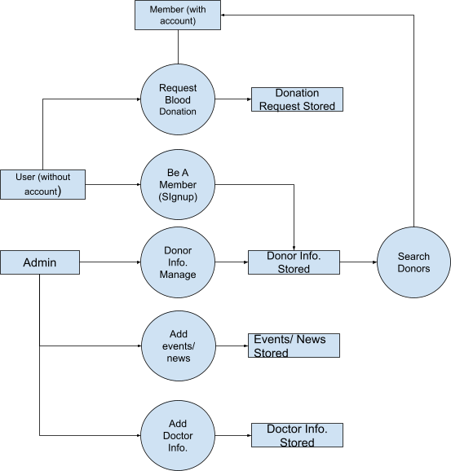
Data Flow Diagram
Fig- Data Flow Diagram of DREAM Website

Slide 6
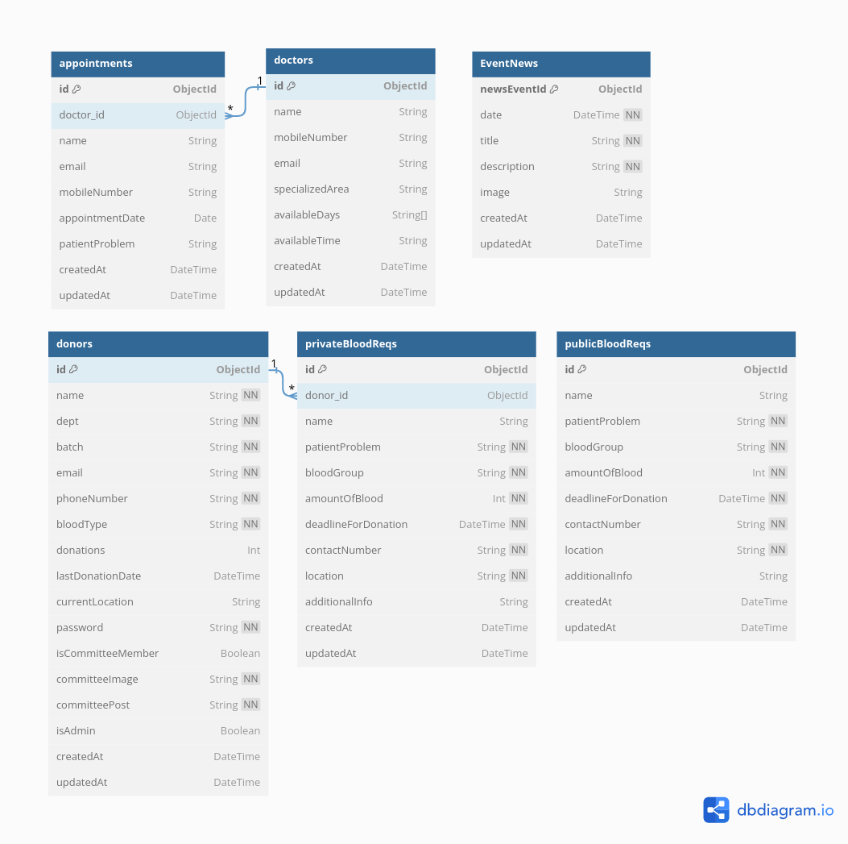
Database Schema

Slide 7
Using Tech Stack
Our Main Tech Stack is MERN (Mongodb, Express.js, React.js, Node.js)
Version Control
Git: Manage code versions, collaborate effectively, and track changes.
IDE
Visual Studio Code: Primary editor for React.js and Express.js development.
Front-End
React.js: Build dynamic user interfaces for blood donor management.
Back-End
Express.js, Node.js: Develop a robust server-side application.
MongoDB: Use a NoSQL database for efficient data storage.

Slide 8
Using Tech Stack (contd…)
Database Management
MongoDB Compass: Visualize and manage MongoDB databases.
API
Telegram API: Send real-time blood request notifications to donors
Additional Packages
Redux, Axios, JWT, React Router: Aid in state management, routing, and authentication control.

Slide 9
Why MERN?
Full Stack JavaScript Development
React for Dynamic UI
Efficient and Scalable
MongoDB for Flexible Data Handling
React Native for Cross-Platform Mobile App
Community Support
Rapid Development
Real-Time Communication

Slide 10
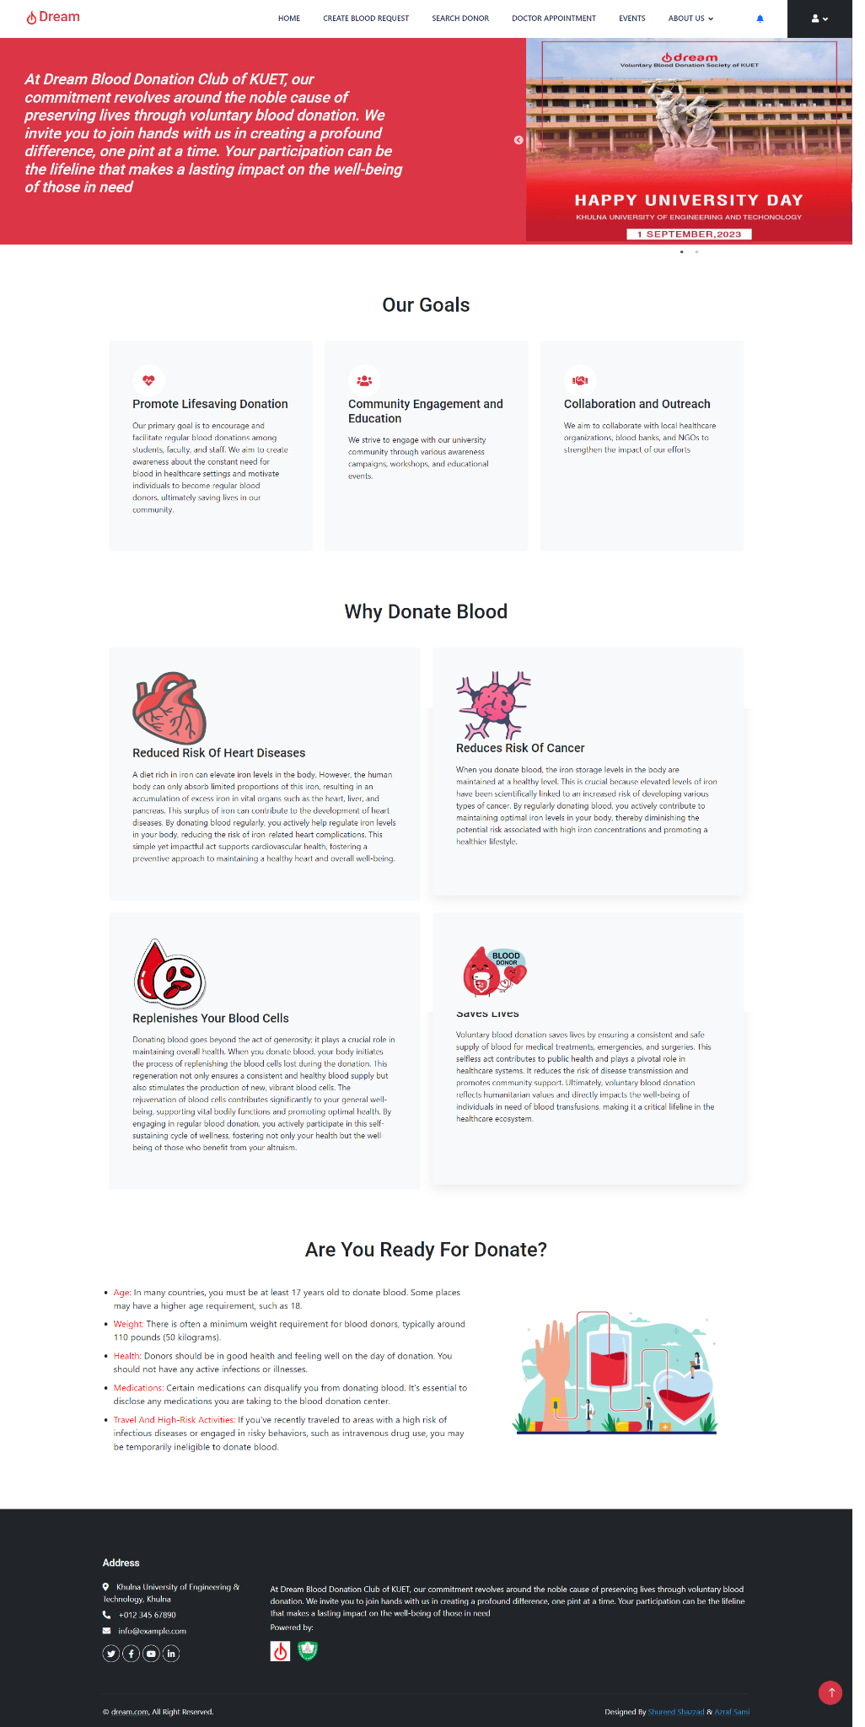
Inspiration for Blood Donation
Home Page
Navbar
Home
Create Blood Request
Search Donor
Kuet Medical Center
Events
About Us
User Profile
Importance of blood donation
Blood donation criteria

Slide 11
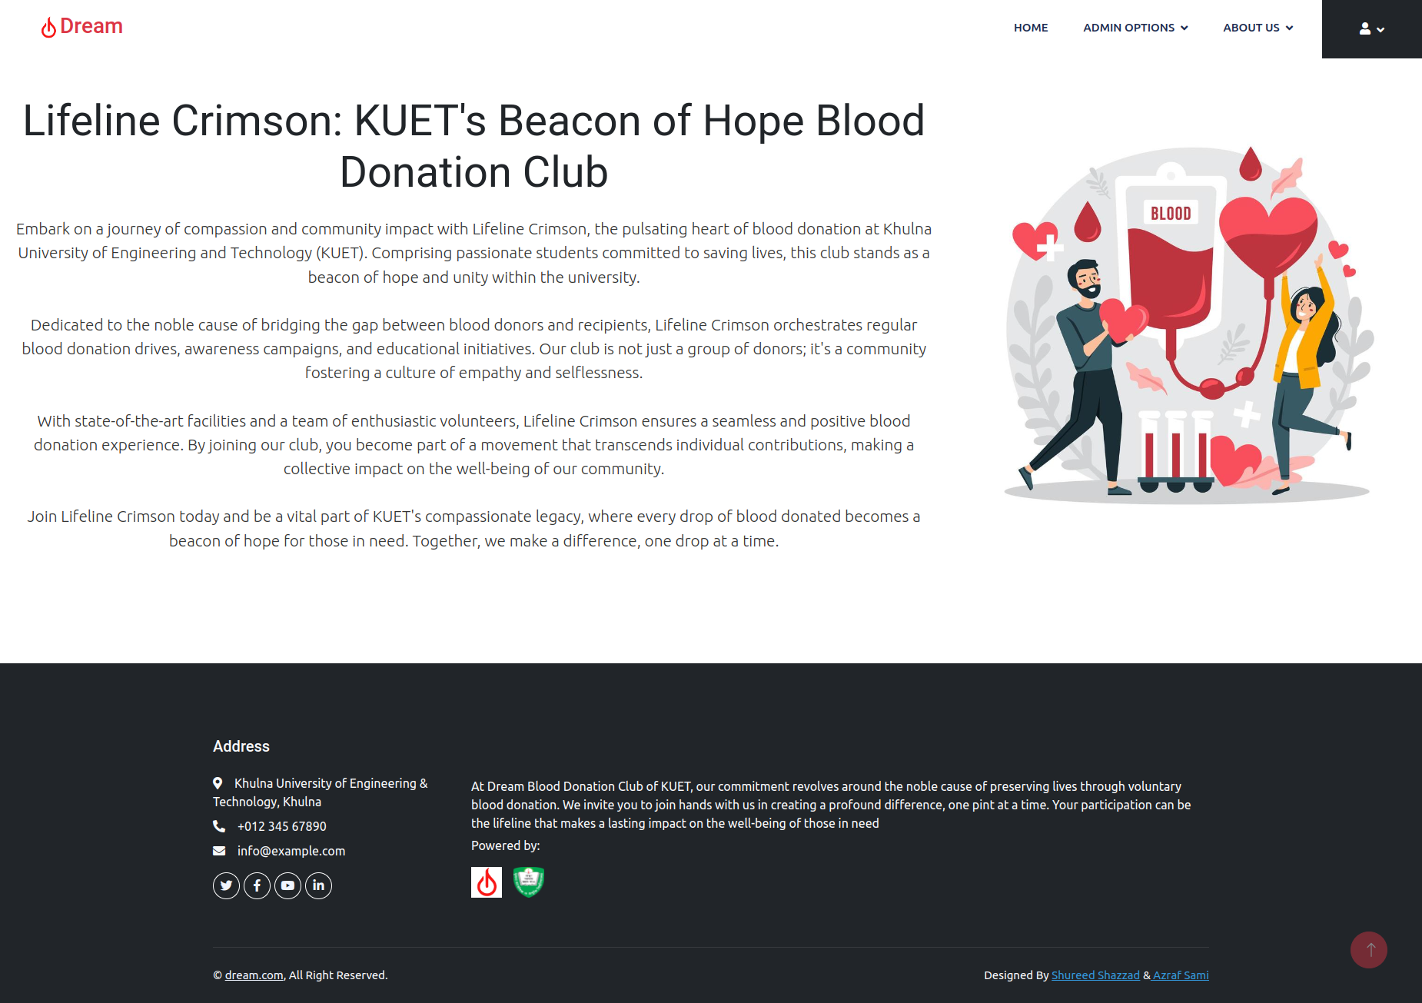
About DREAM
About Us Page

Slide 12
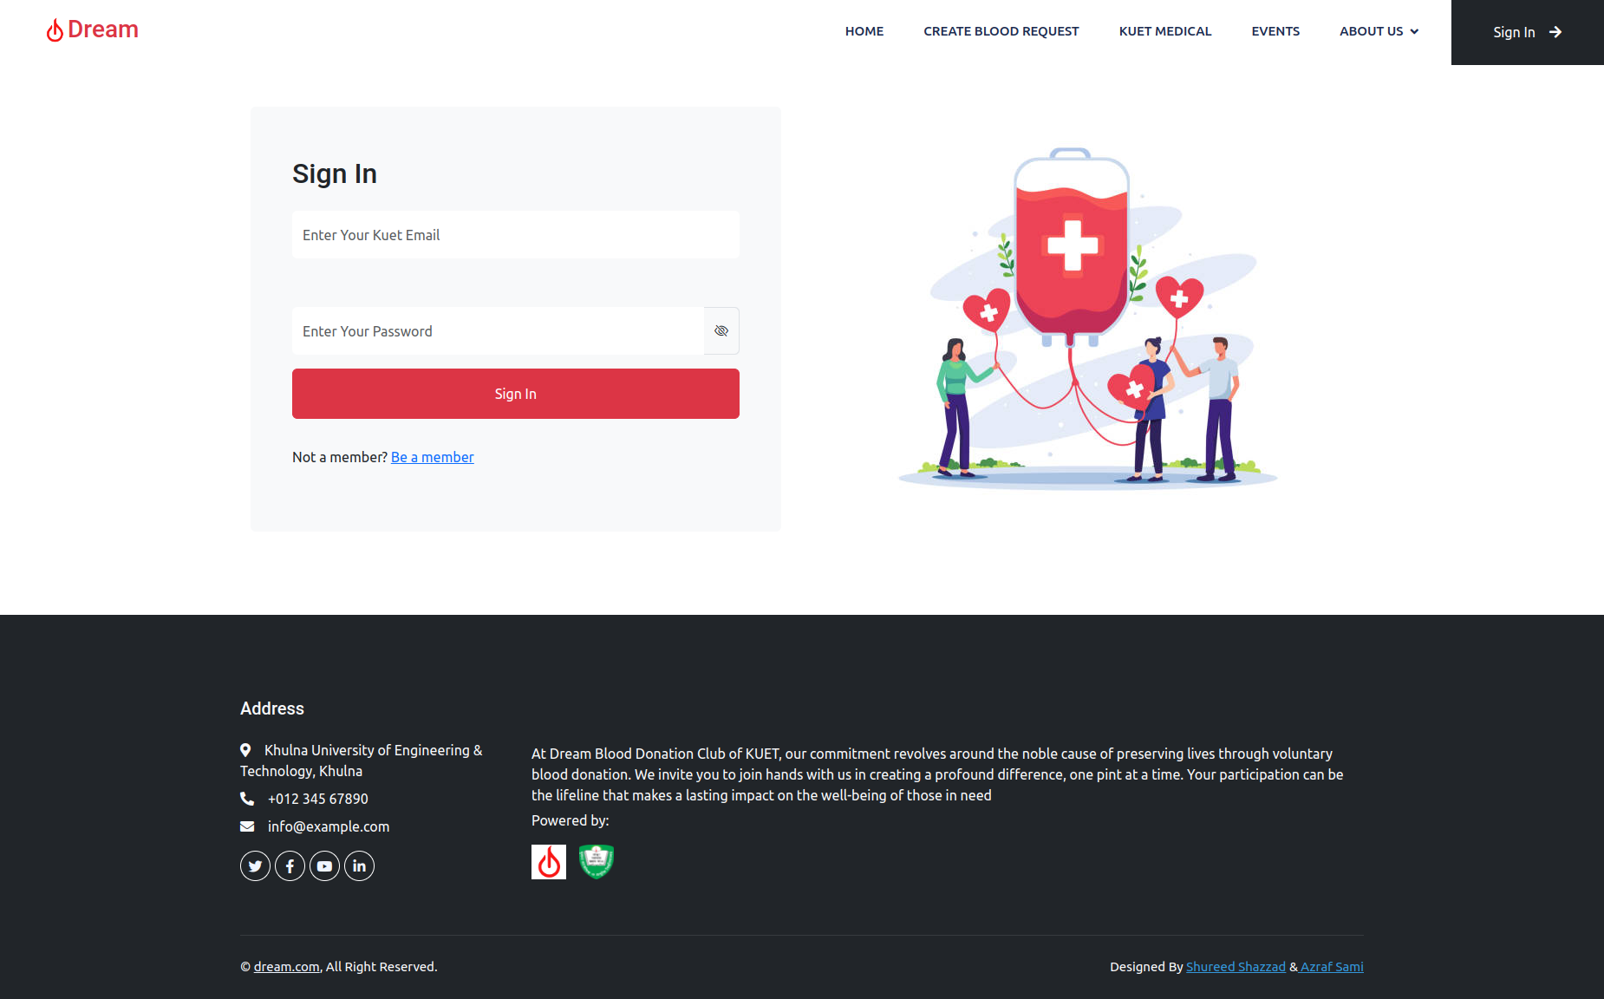
Login
User can login to his account

Slide 13
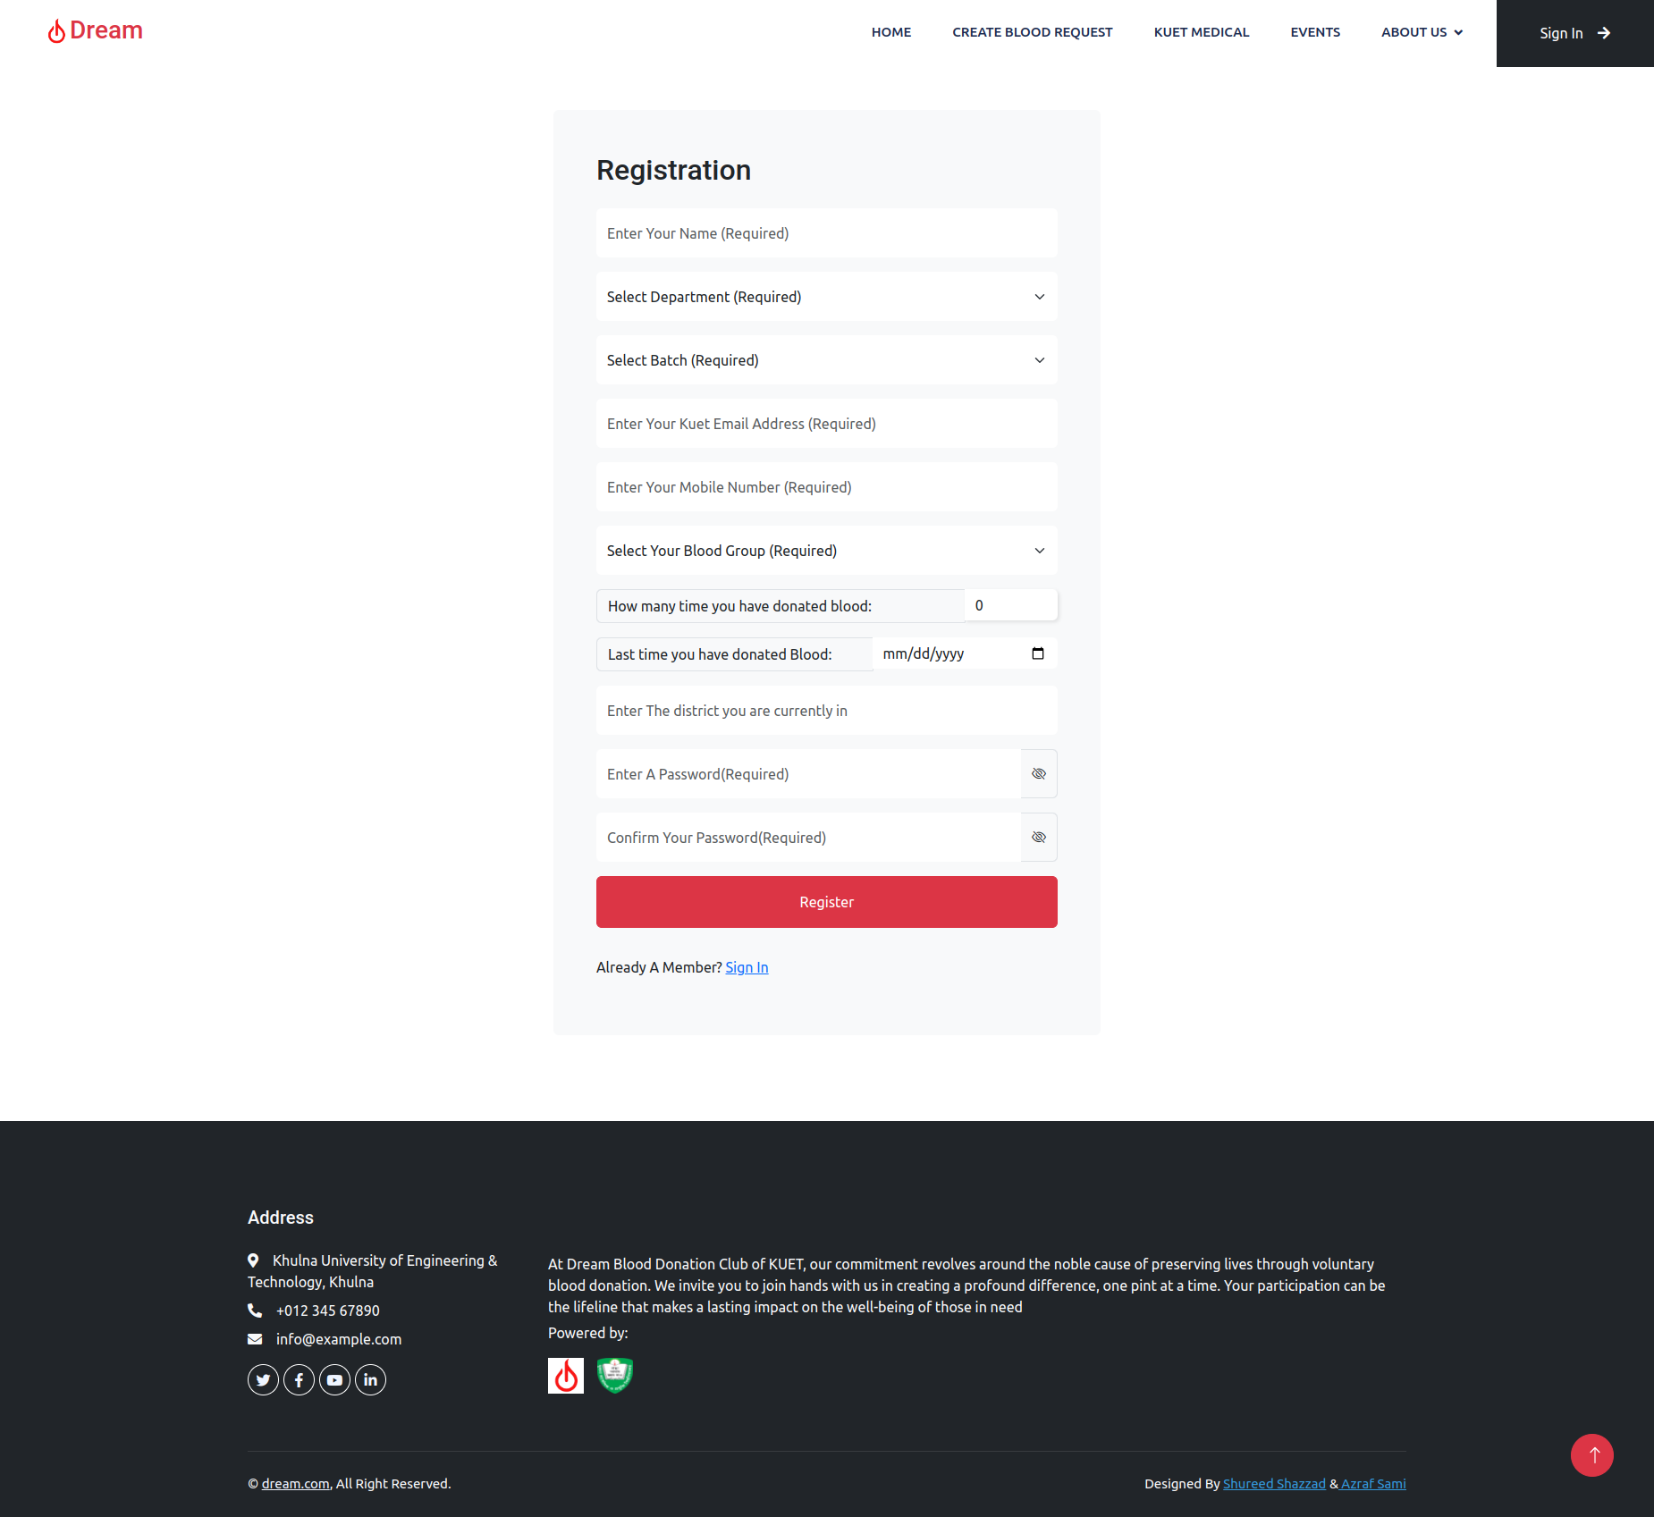
Registration
These information are needed:
Name
Department
Batch
Email (academic mail)
Mobile Number
Blood Group
Frequency of blood donation
Date of last blood donation
District
Password

Slide 14
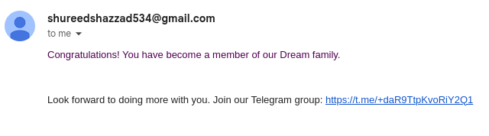
Registration (contd…)
“Telegram Group” invitation link.

Slide 15
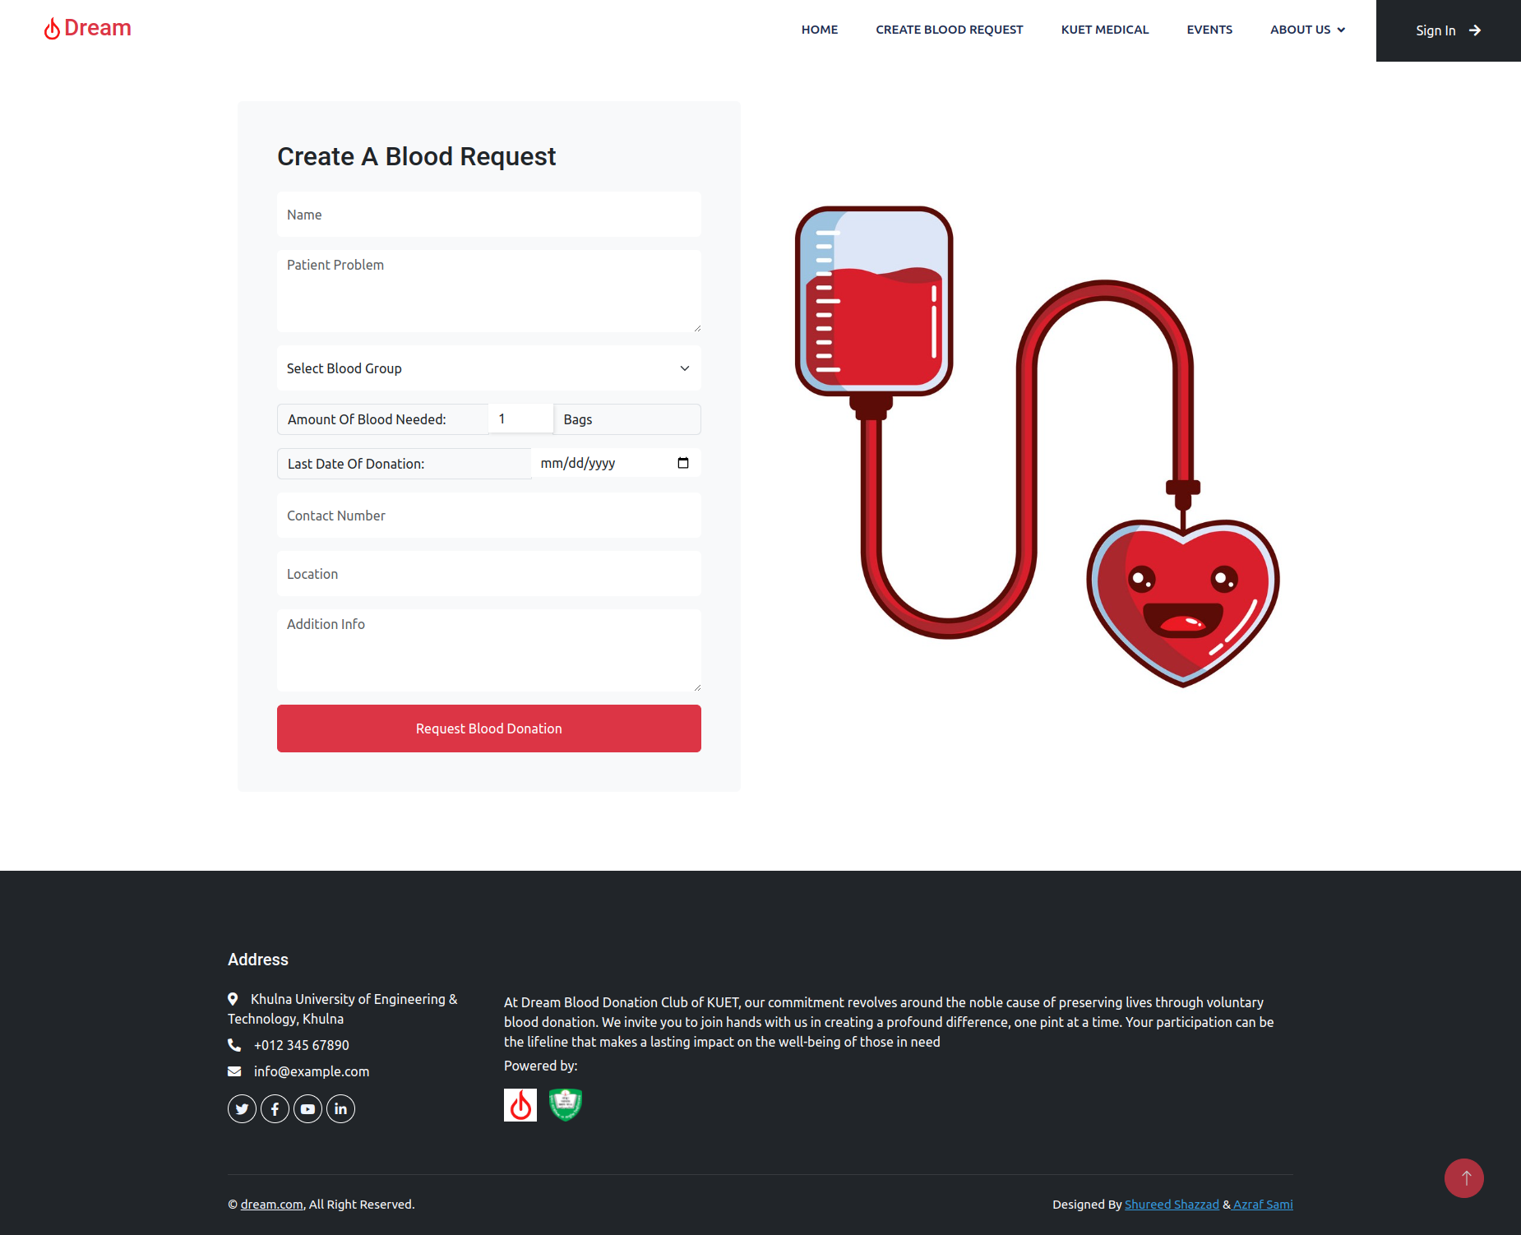
Blood Request System
User with account or without account can create a blood request
Needed Information:
Name
Patient Problem
Select Blood Group
Amount of Blood
Last Date of Donation
Contact
Location
Address Info

Slide 16
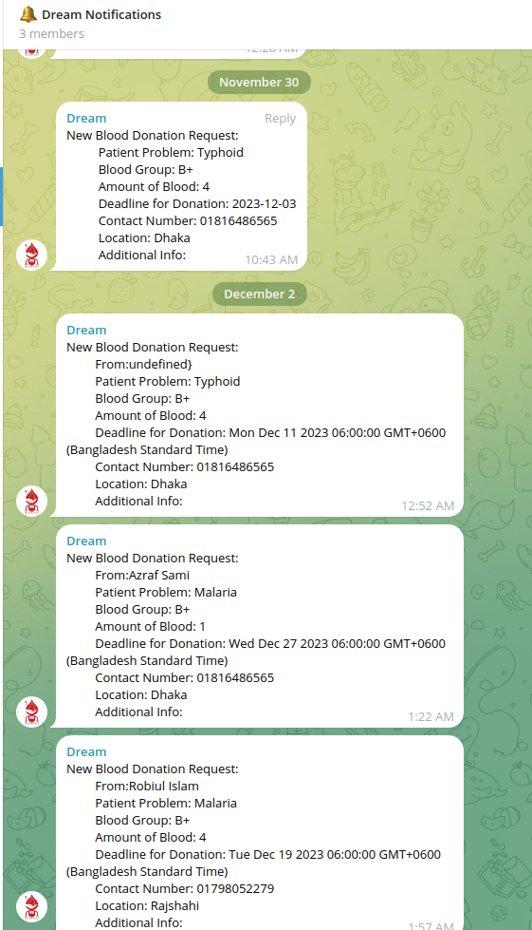
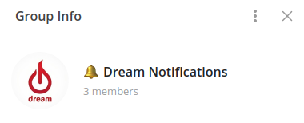
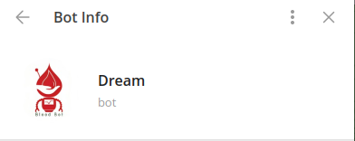
Blood Request System (contd…)
Telegram Group of Blood Donors
All blood request notifications are automatically sent by a “Dream” - the Telegram bot
By joining this group, donors will be notified about the needed blood via a mobile device without the need to stay on the website or go through a login process

Slide 17
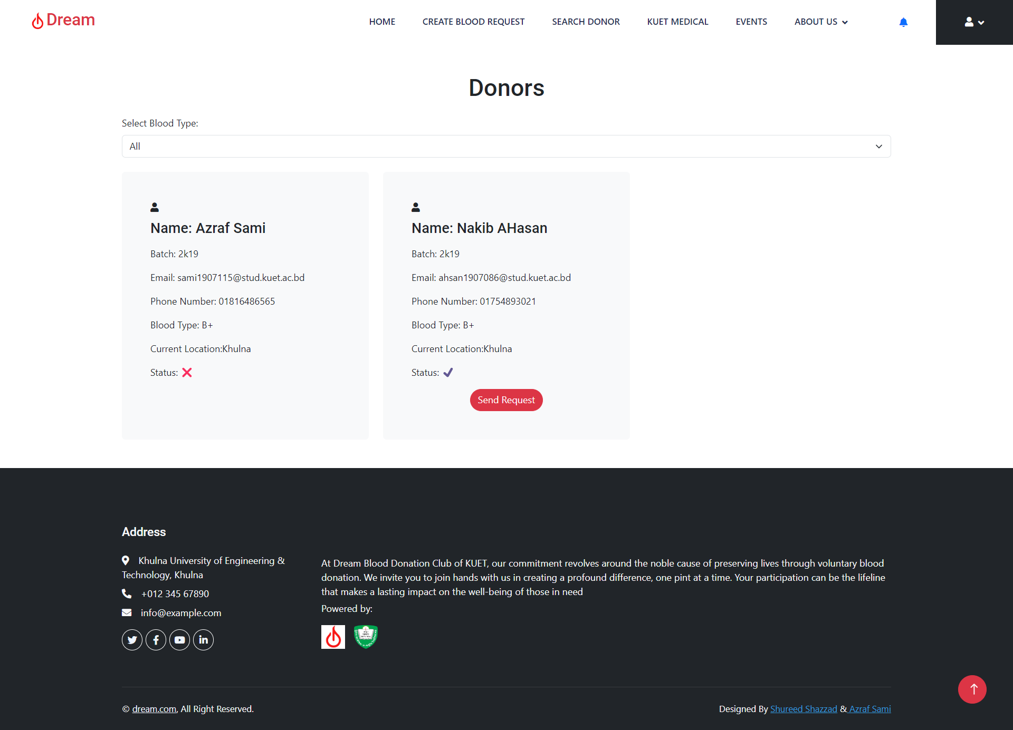
Search Donors
Filter Donors by blood group
Status ‘’❌️” means donors is not available.
Status ‘’✔️” means donors is available.
After the last blood donation date, the donor status will be unavailable automatically for four months. After four months, the donor status will be available.
After clicking on a “send request” button , email notification will send to a donor.

Slide 18
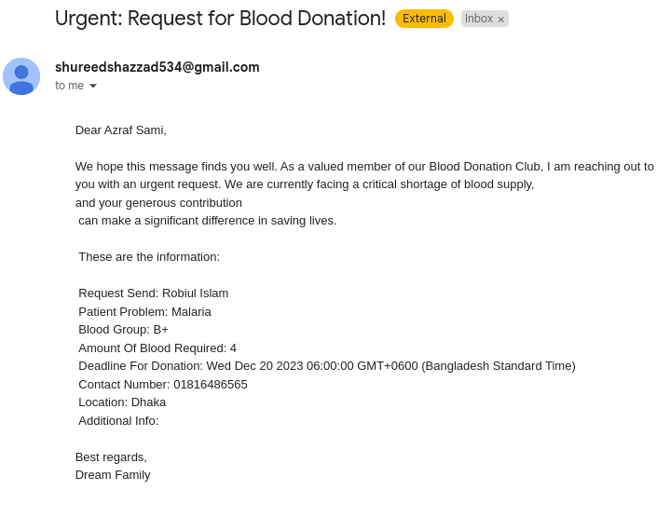
Email Notification to Donor
Name of Donor
Detail information of patient who needs blood immediately.

Slide 19
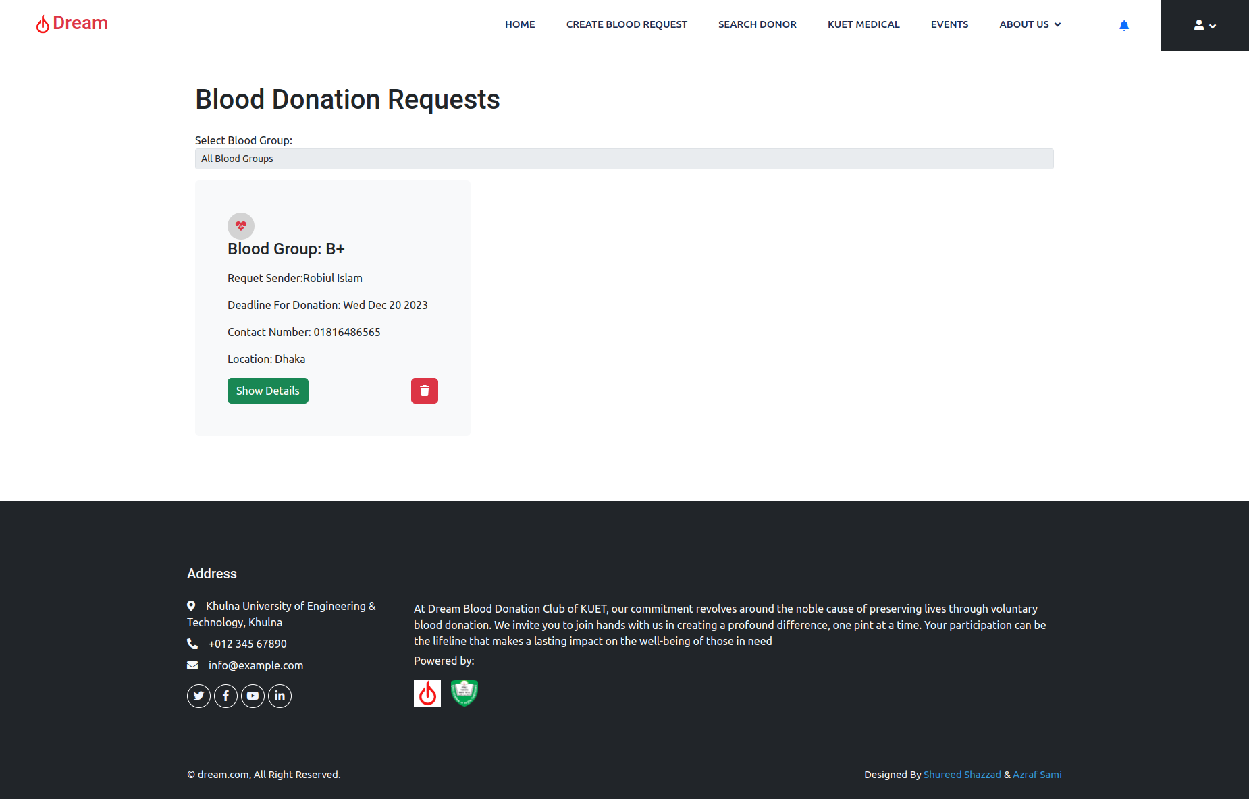
Web Notification to Donors
Clicking on bell icon, donor can see all notification.
From this button, donor can see notification details.
Donor can delete this notification.
After deadline for donation, blood request will be deleted automatically

Slide 20
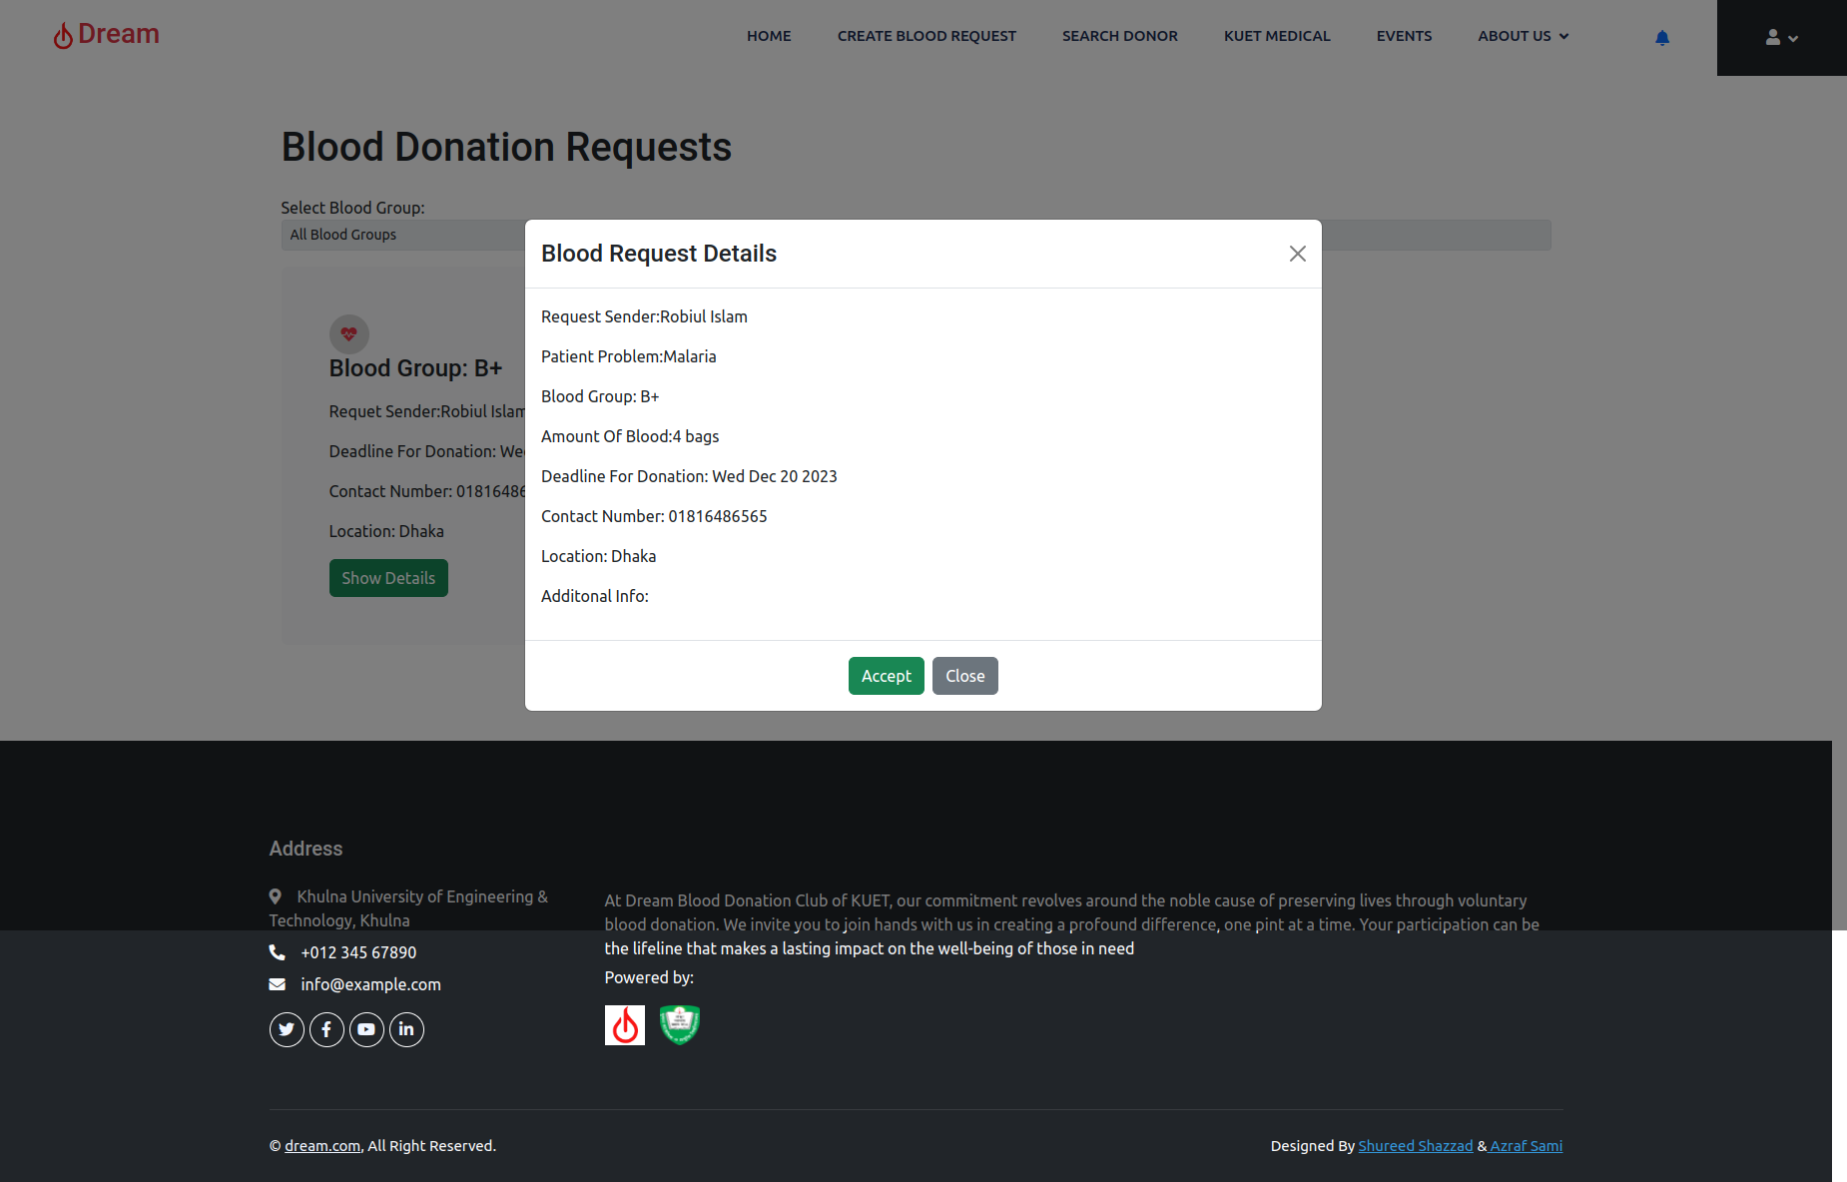
Web Notification to Donor (contd…)
After clicking the 'Show Details' button, a popup screen will appear. Here, the donor can accept the request. Upon confirmation, a 'Blood Request Accepted!' email will be sent to the patient who requested blood.

Slide 21
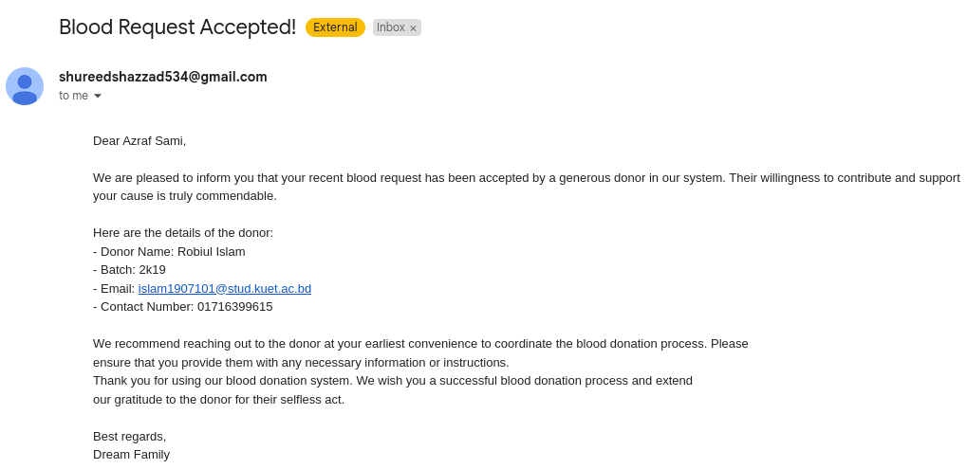
“Blood Request Accepted” Mail
Name of Patient
Detail information of donor who accepts blood donation request.

Slide 22
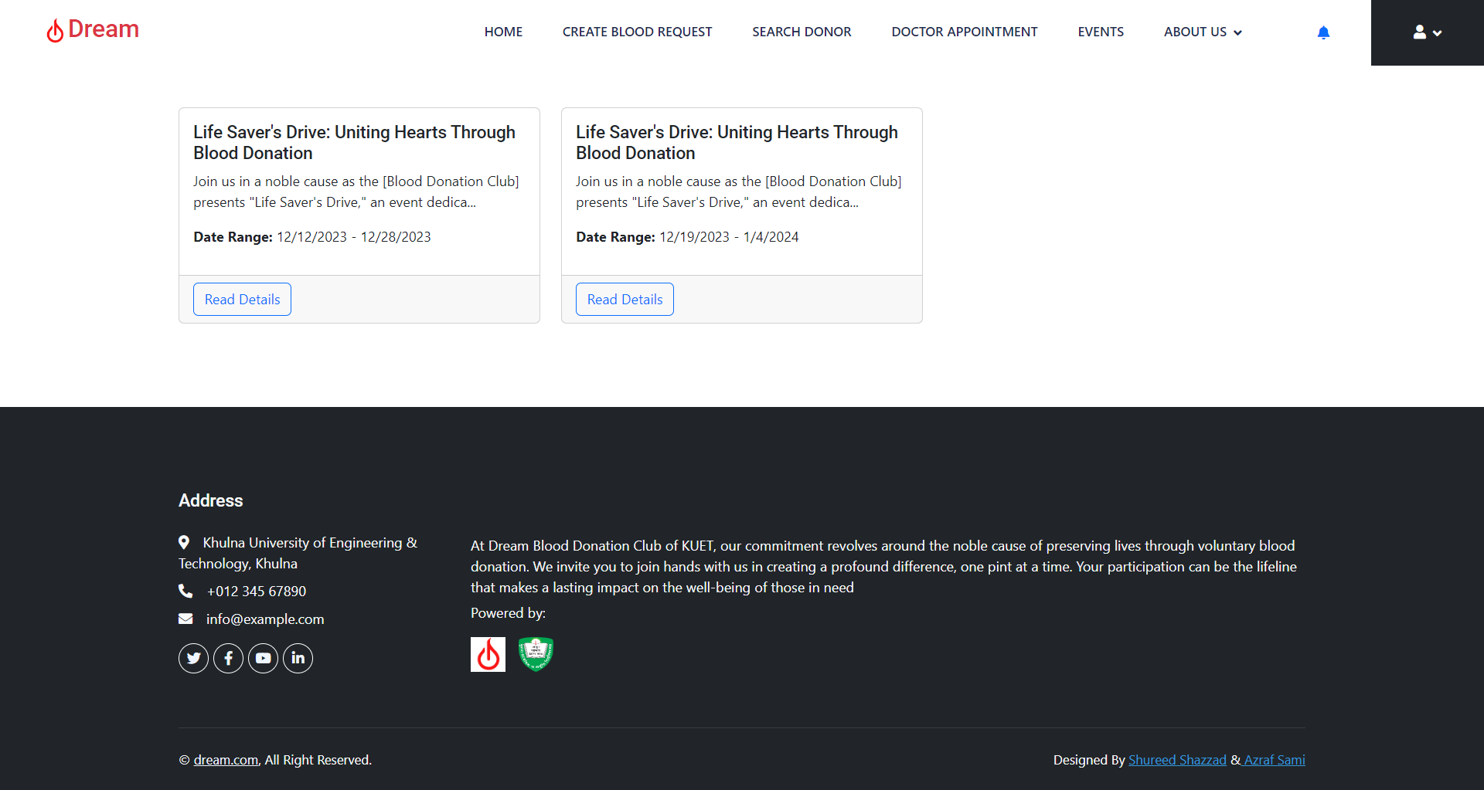
Event and News Notifications
User can see Events/News of this club
“Read Details” button to see detail information of event

Slide 23
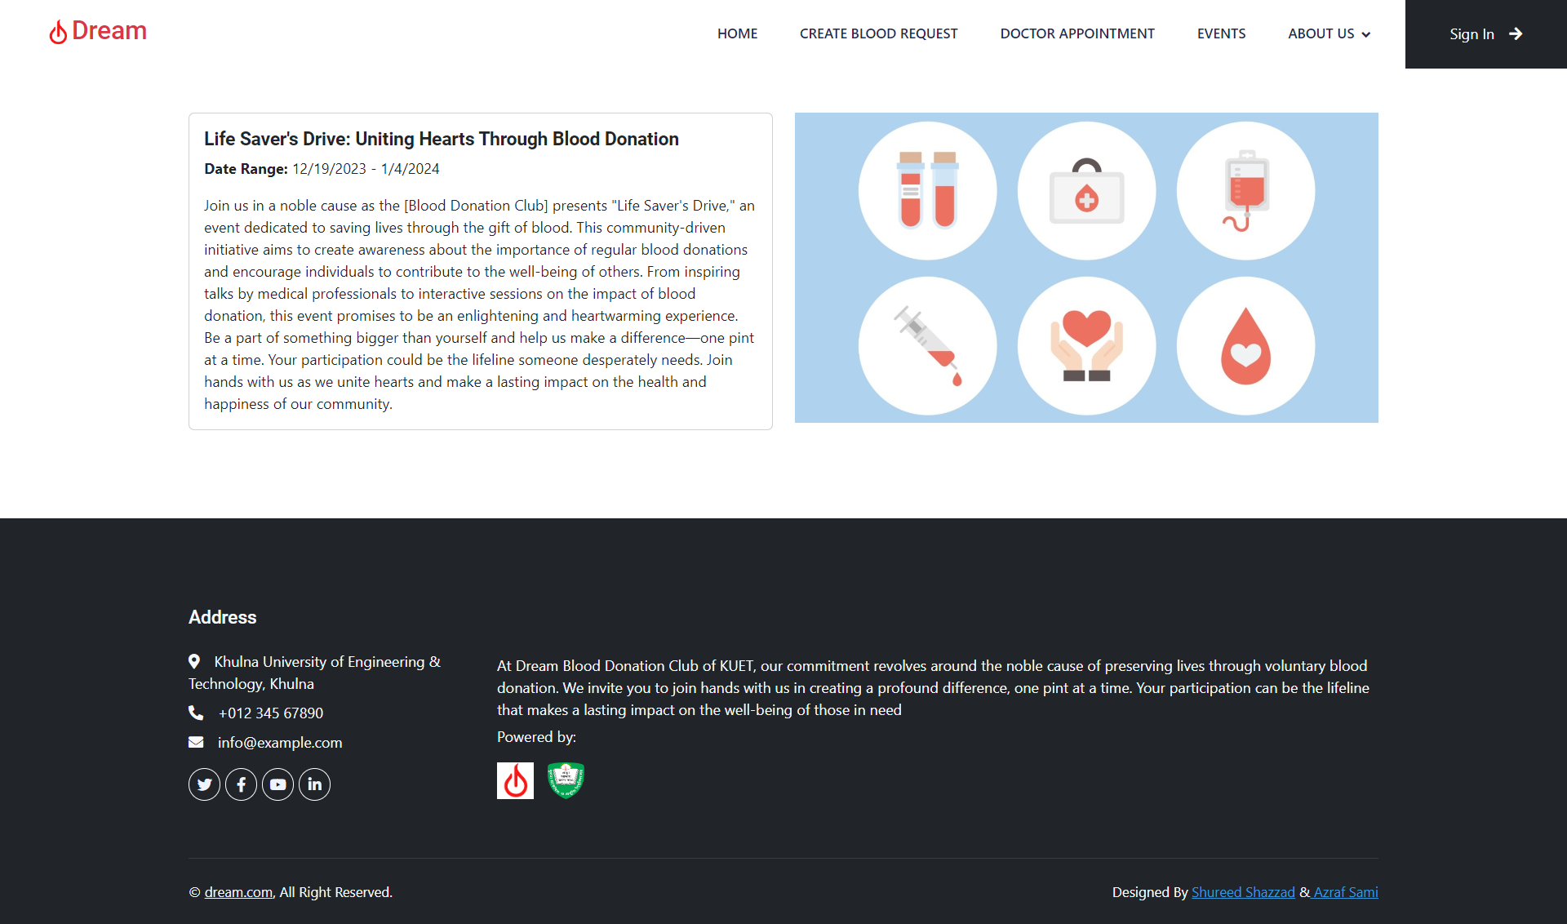
Event and News Notifications (contd…)
After clicking “Read Details” button, user will be redirected to page to see detail information of events

Slide 24
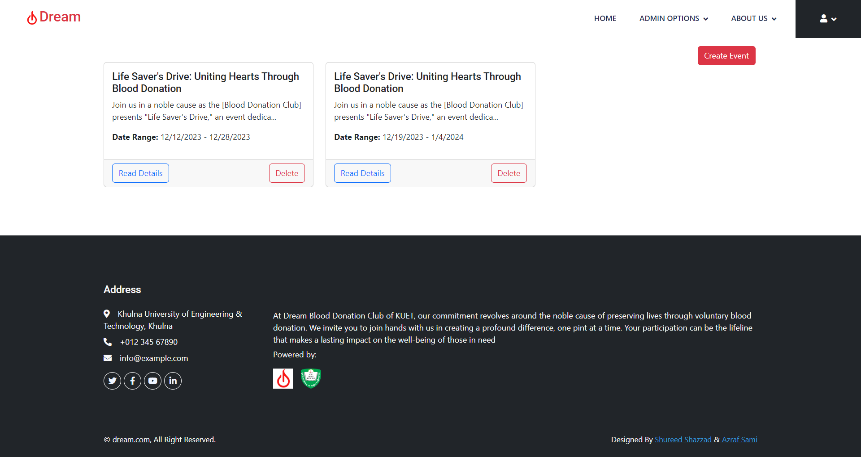
Manage Event and News Notifications (contd…)
Controlled by Admin Panel
Admin can create any event post
Admin can delete event post

Slide 25
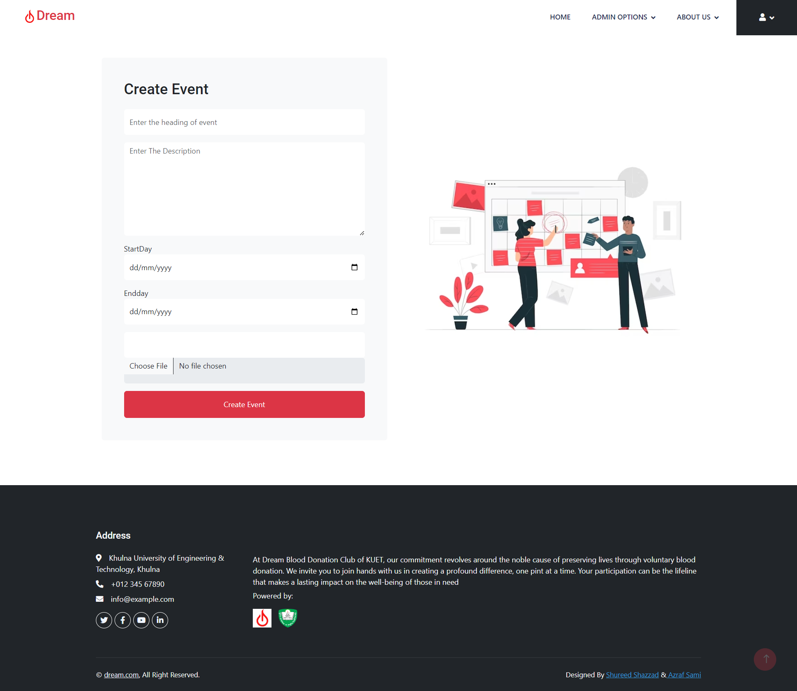
Manage Event and News Notifications (contd…)
Controlled by Admin Panel
Admin can create any event post by giving detailed information like heading, description, starting date, ending date and also can upload an image.

Slide 26
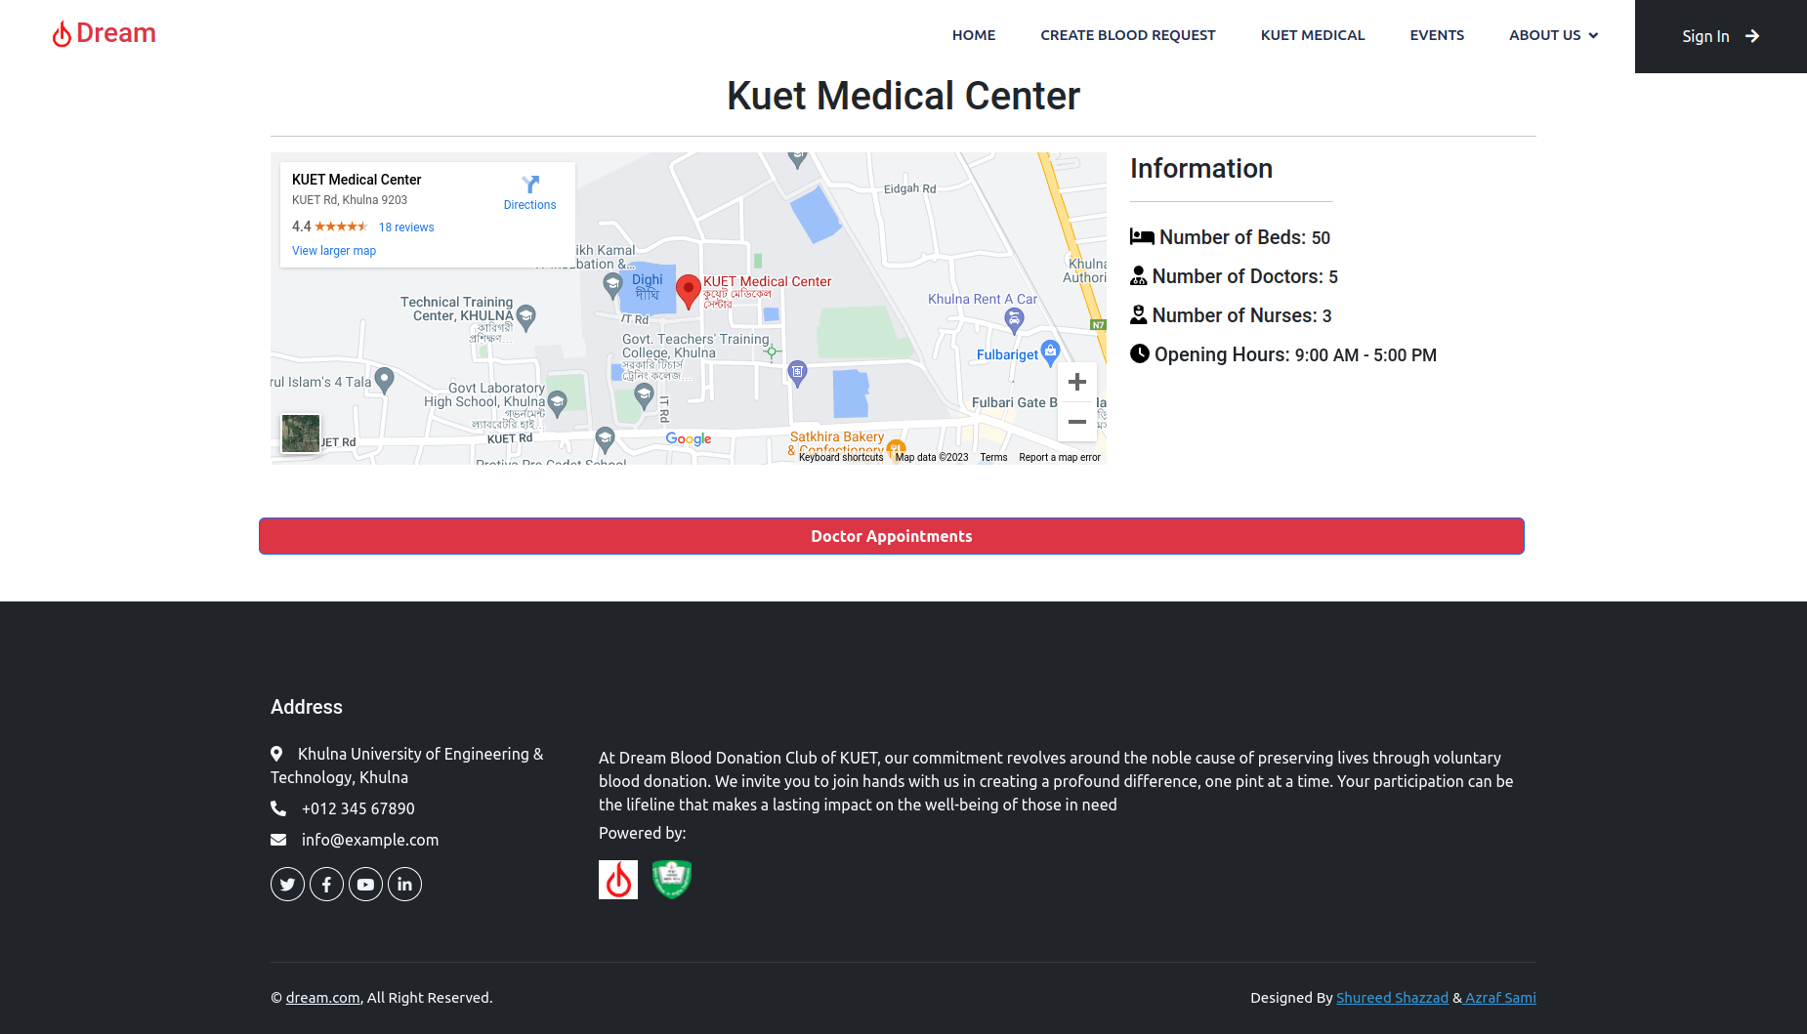
Kuet Medical Center
Basic Information of Kuet Medical Center like number of beds, doctors, nurses, opening hours
Google map location of Kuet Medical Center
Schedule a doctor appointment at Kuet Medical Center.

Slide 27
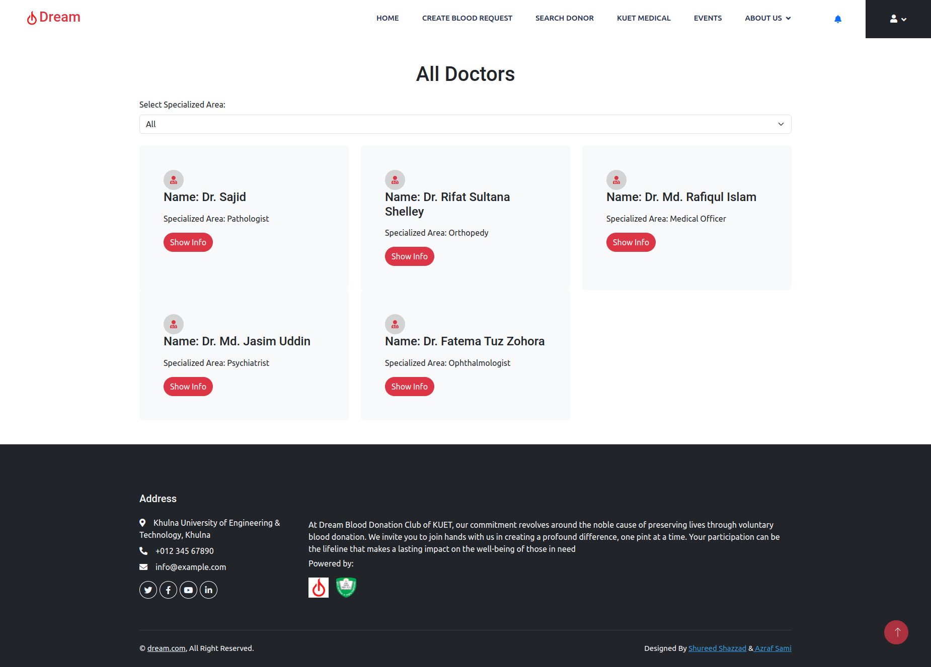
All Doctors
User can see all doctor profile from this page

Slide 28
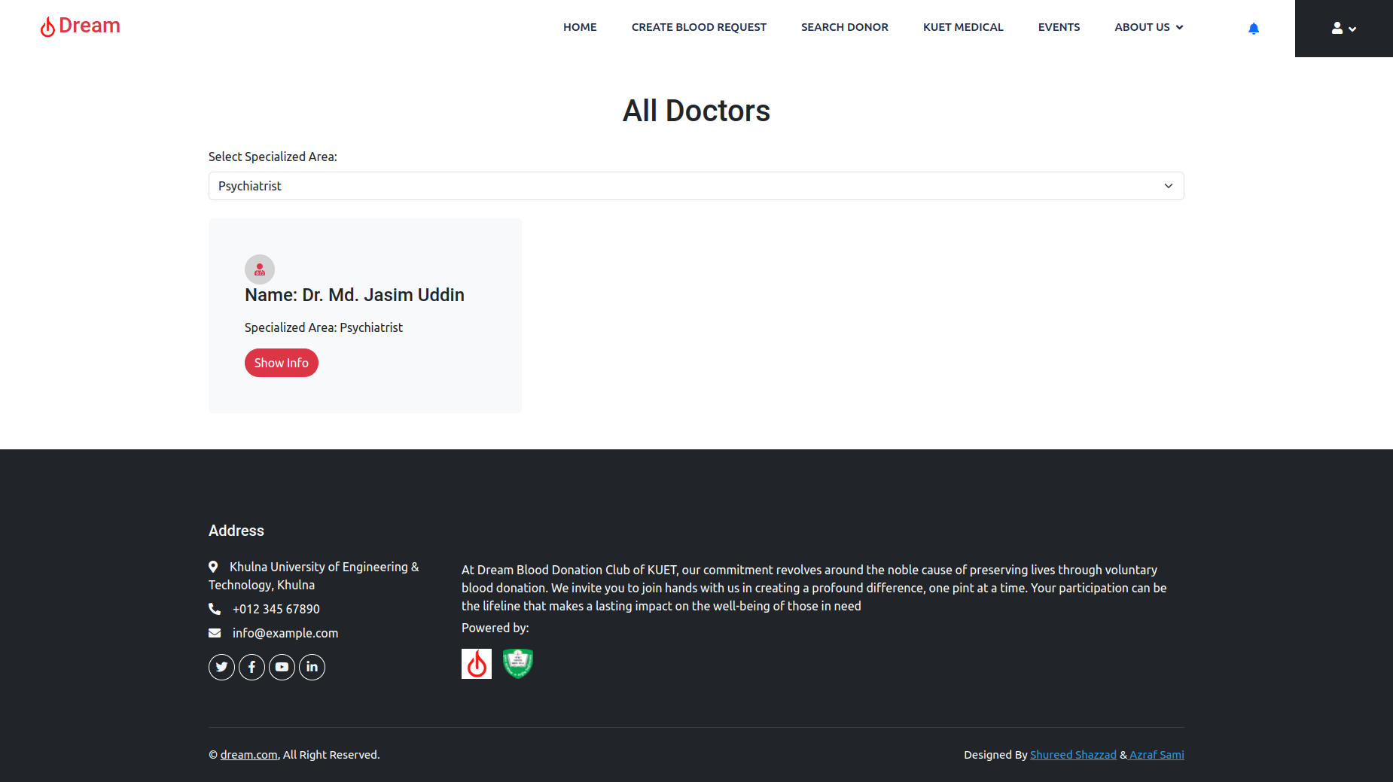
All Doctors (contd…)
User can filter doctor profile by speciality.
Clicking “Show Info” button, user can see more details

Slide 29
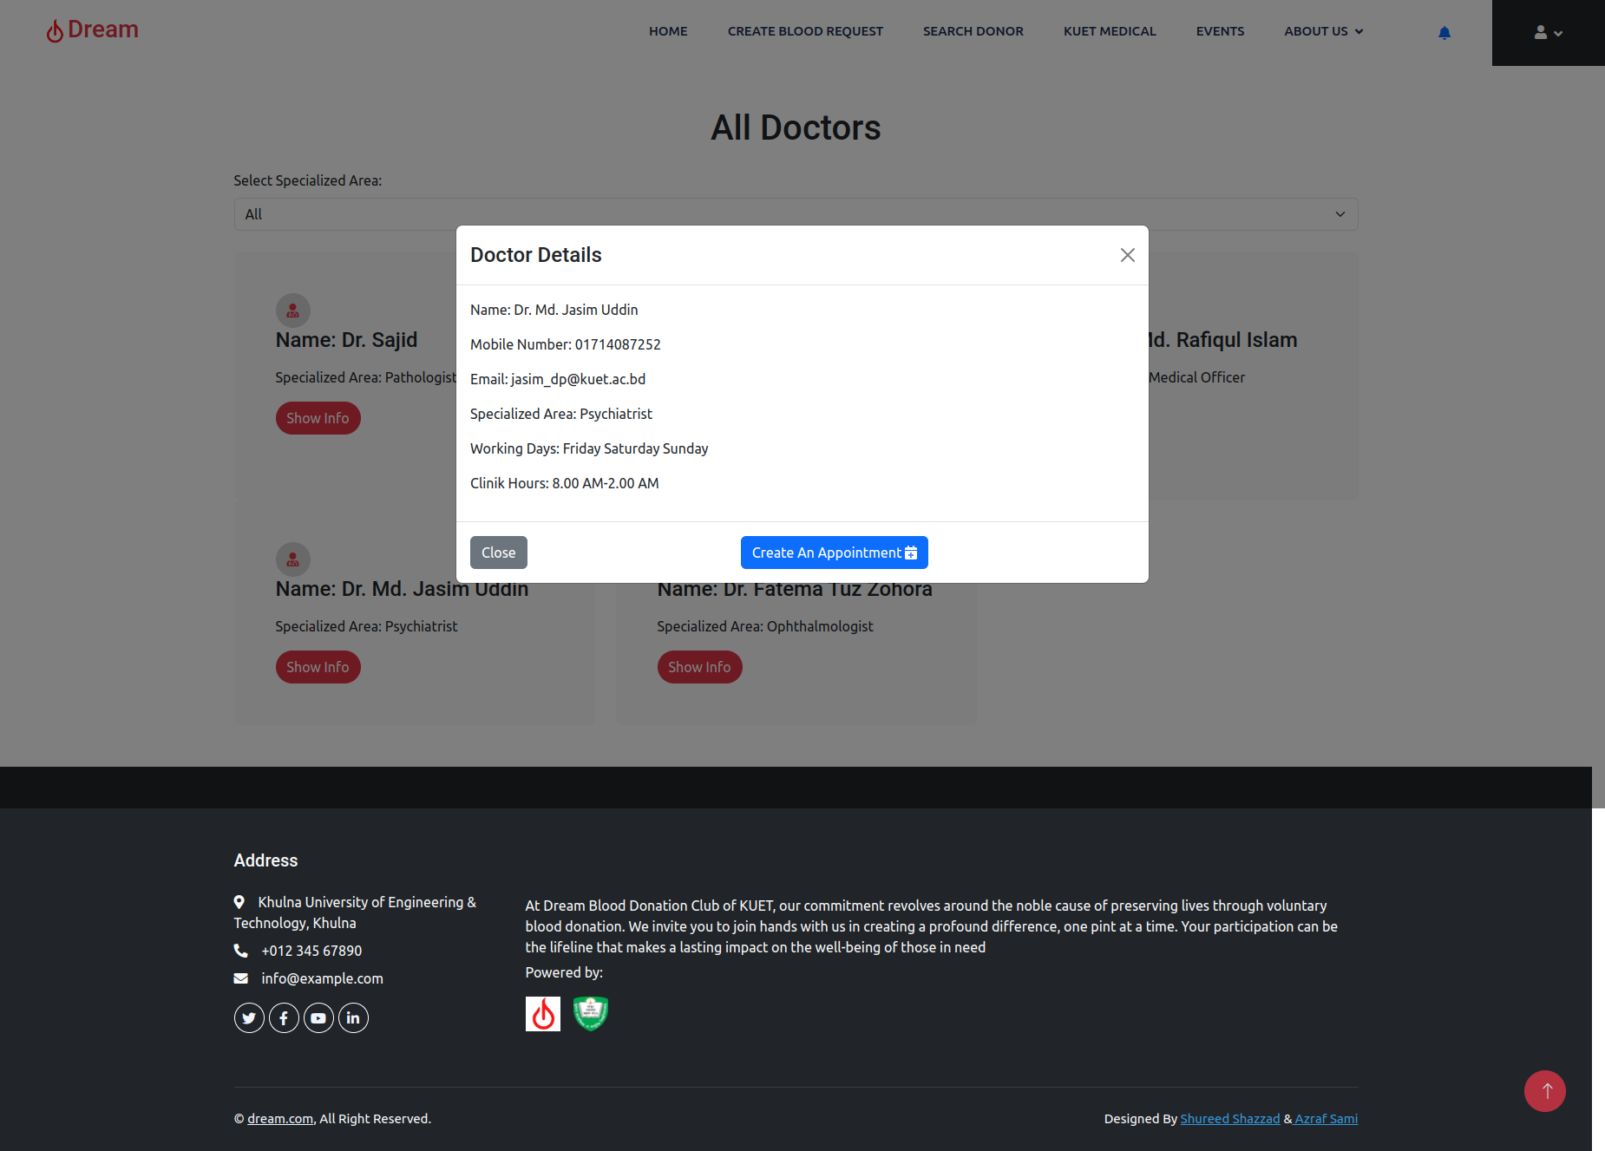
All Doctors (contd…)
After clicking on “Show info” button, popup of doctor’s details will be appeared
By clicking on “Create an appointment” button, user can schedule for a doctor appointment

Slide 30
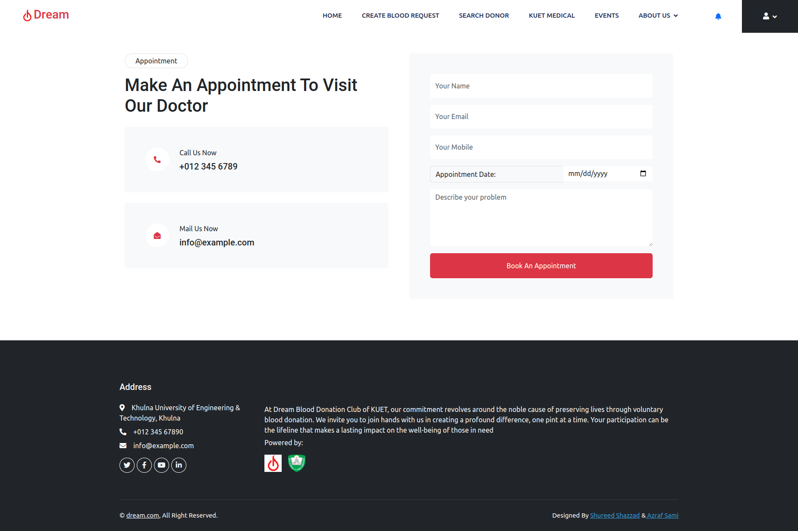
Doctor Appointment Form
Doctor appointment form
Needed Information:
Name
Email
Mobile Number
Appointment Date
Health Problem Description

Slide 31
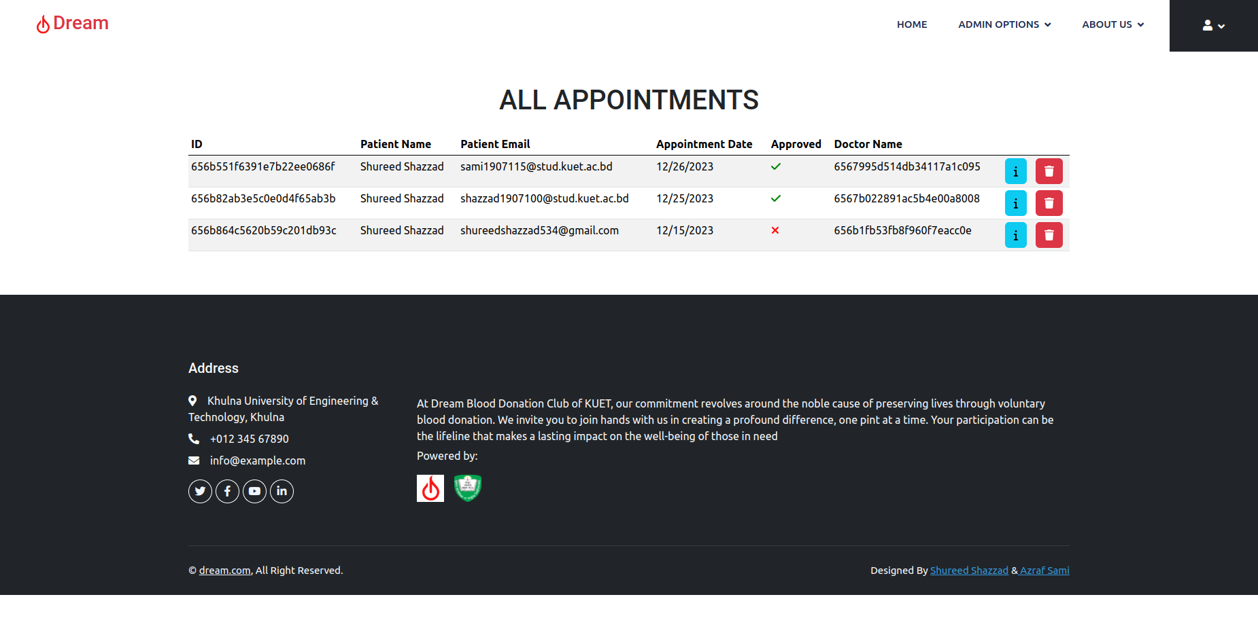
Appointment Management Dashboard (Admin Panel)
Admin can approve doctor appointment
Admin can delete doctor appointment
“✅️” means this doctor appointment is approved by admin
“❌️” means this doctor appointment isn’t approved by admin yet

Slide 32
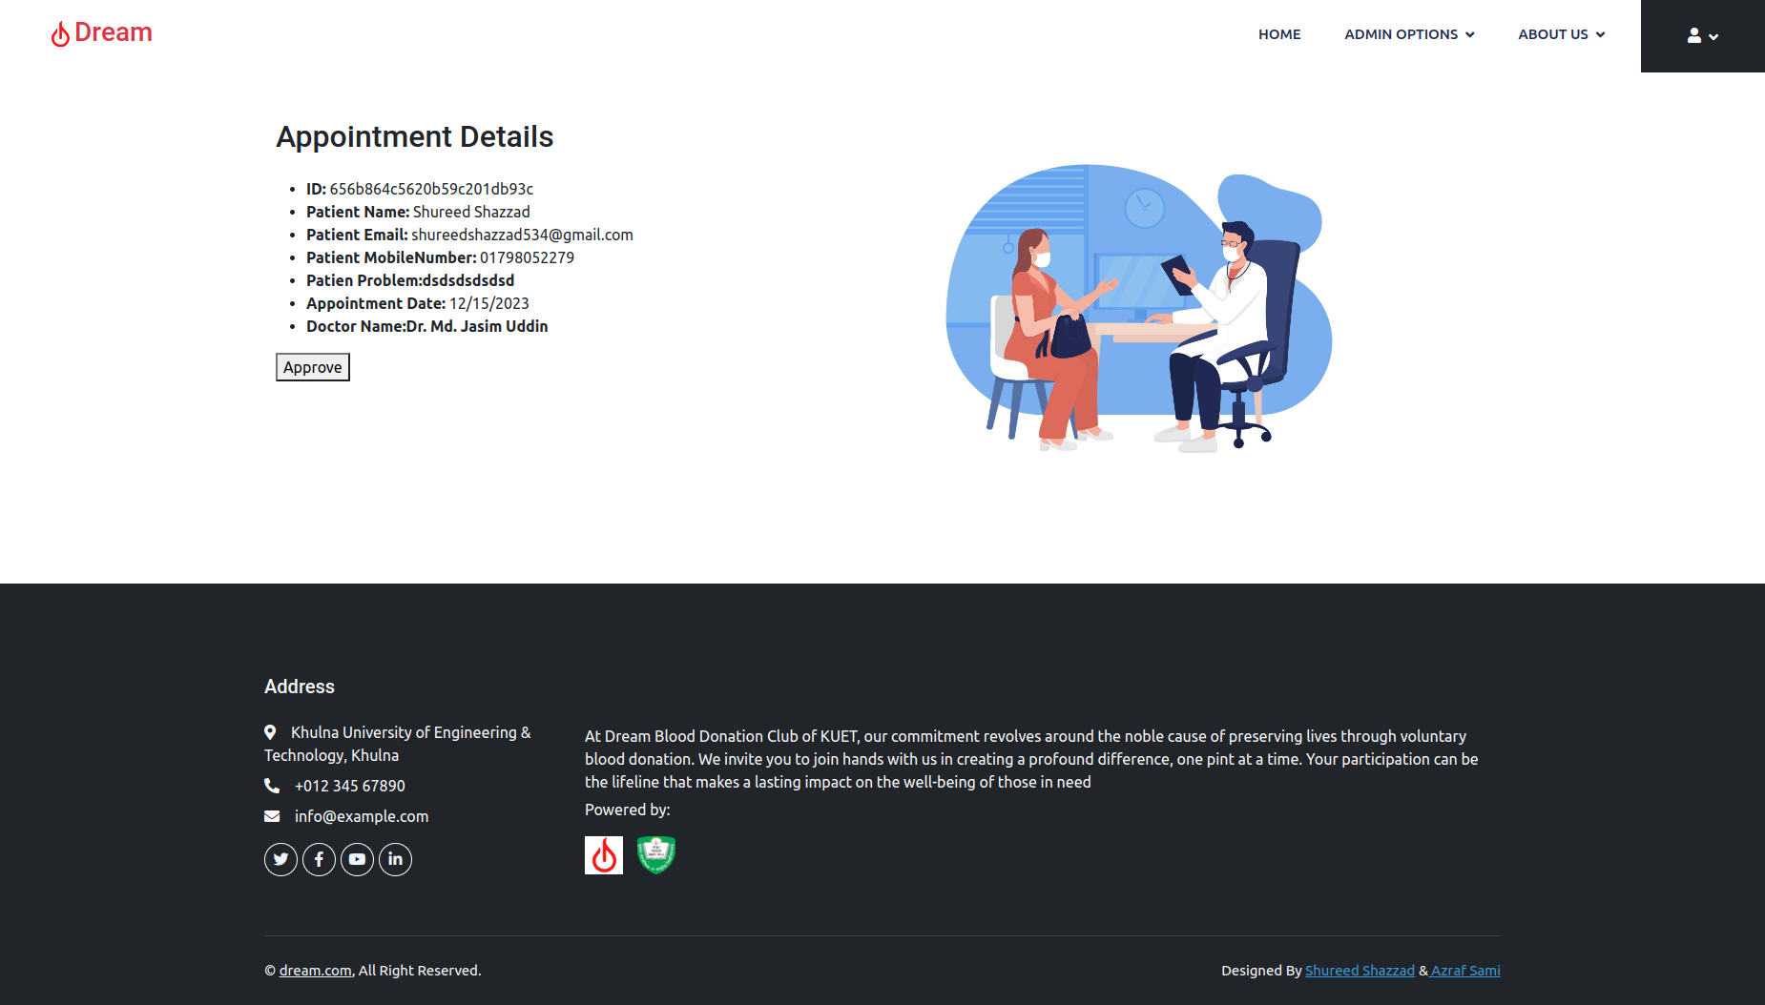
Appointment Approval (Admin Panel)
After approval of doctor appointment, a email notification will sent to the patient’s email and approval button will be disappeared

Slide 33

Appointment Approval (Admin Panel)
Approval button is disappeared

Slide 34
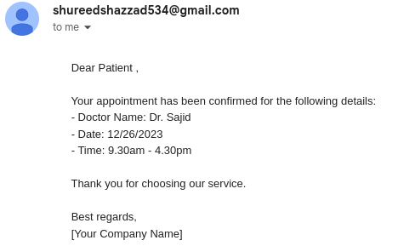
Appointment Approval Email
Appointment approval email sent to a patient’s email after admin approval
Doctor’s Information

Slide 35
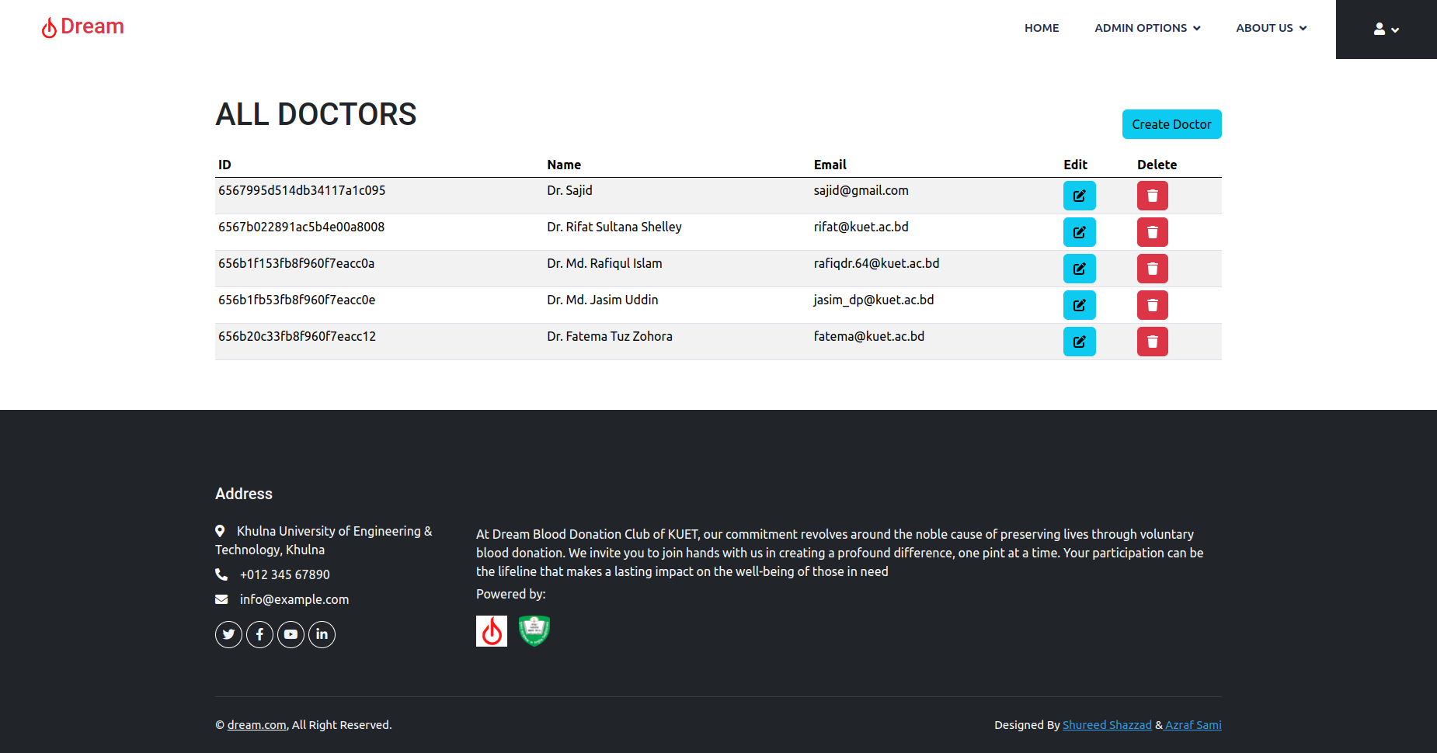
All Doctors (Admin Panel)
Admin can create new doctor profile
Admin can edit doctor profile
Admin can delete doctor profile

Slide 36
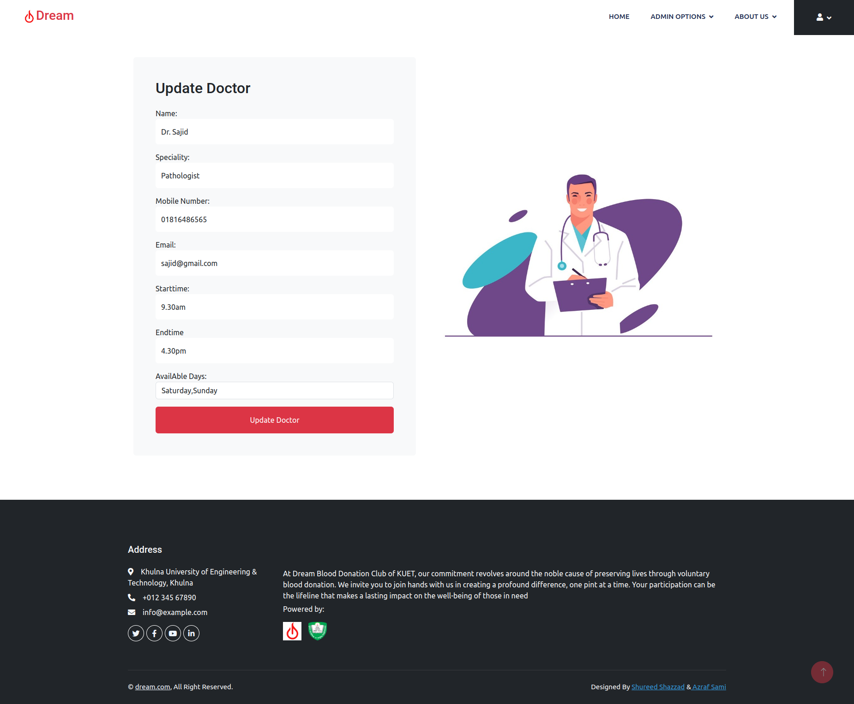
Update Doctor’s Information (Admin Panel)
Admin can update doctor’s information

Slide 37
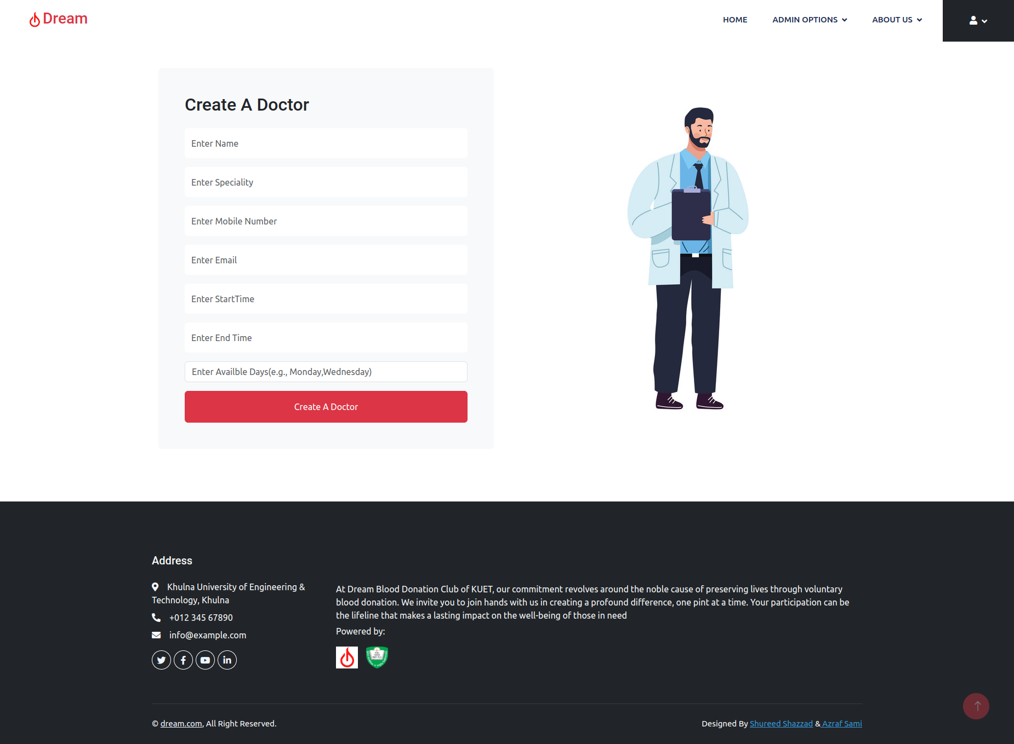
Creating A Doctor Profile (Admin Panel)
Admin can create a new doctor profile
Needed Information:
Name
Speciality
Mobile Number
Email
Duty Starting Time
Duty Ending Time
Available working days

Slide 38
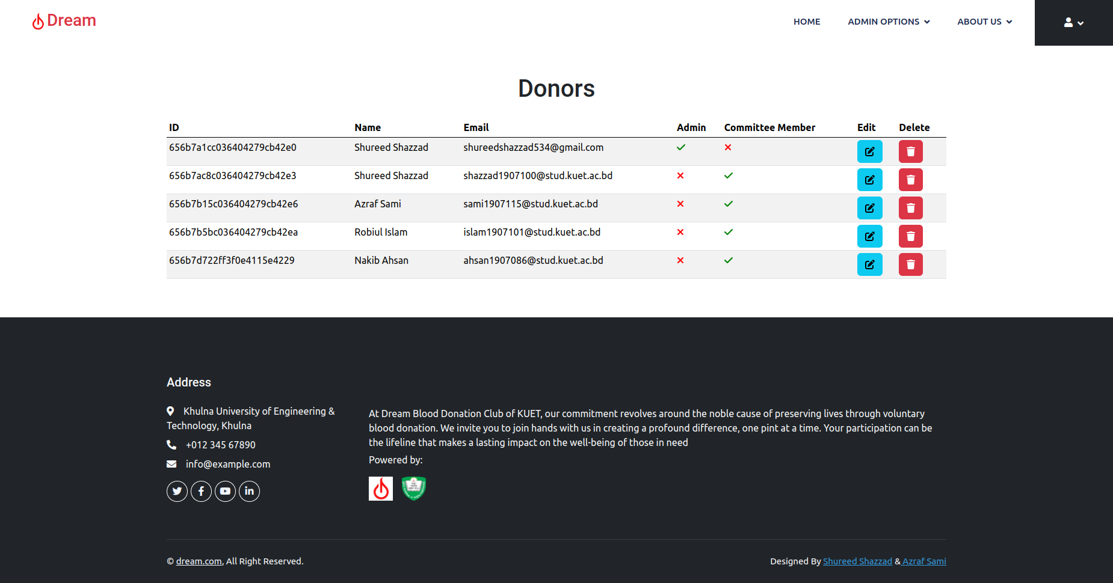
Donors Information Management (Admin Panel)
This donor is a admin or a general user
Committee member or not
Admin can edit donor information
Admin can delete donor ID

Slide 39
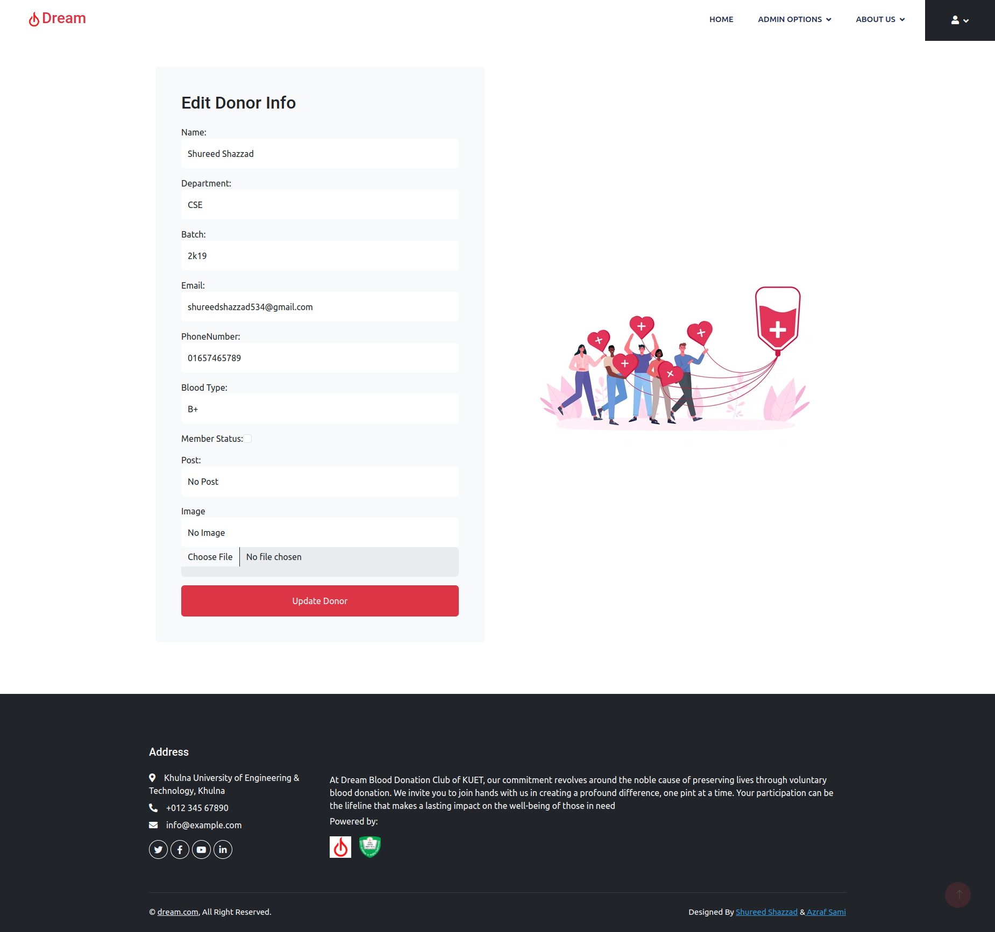
Donors Information Edit (Admin Panel)
Admin can edit donor’s information
If this donor is a member of the executive committee of DREAM, the admin should check the checkbox

Slide 40
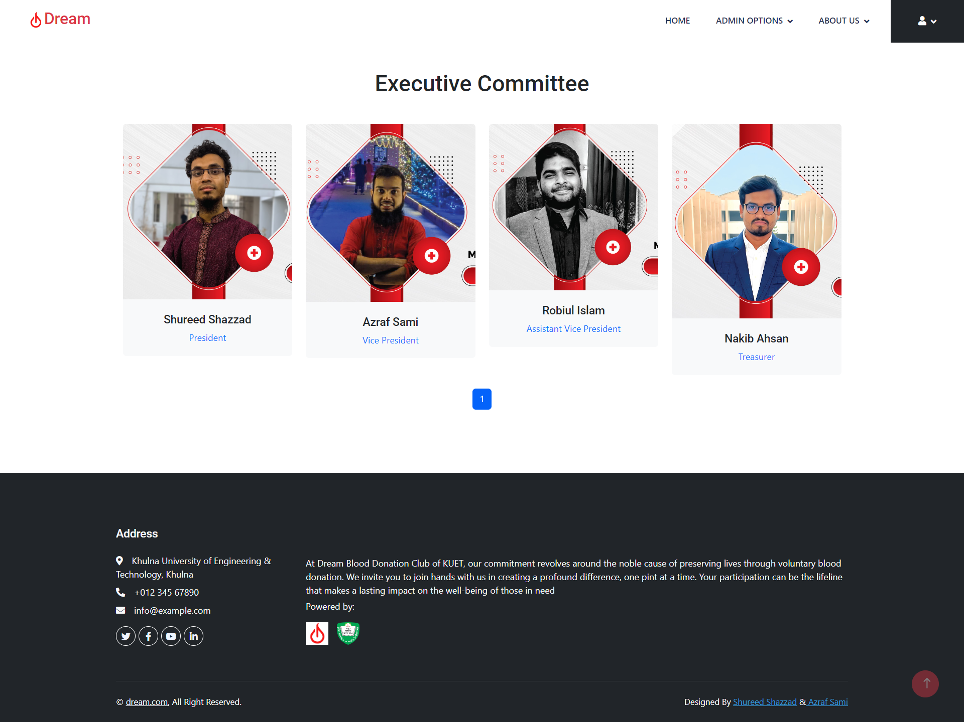
Executive Committee of DREAM

Slide 41
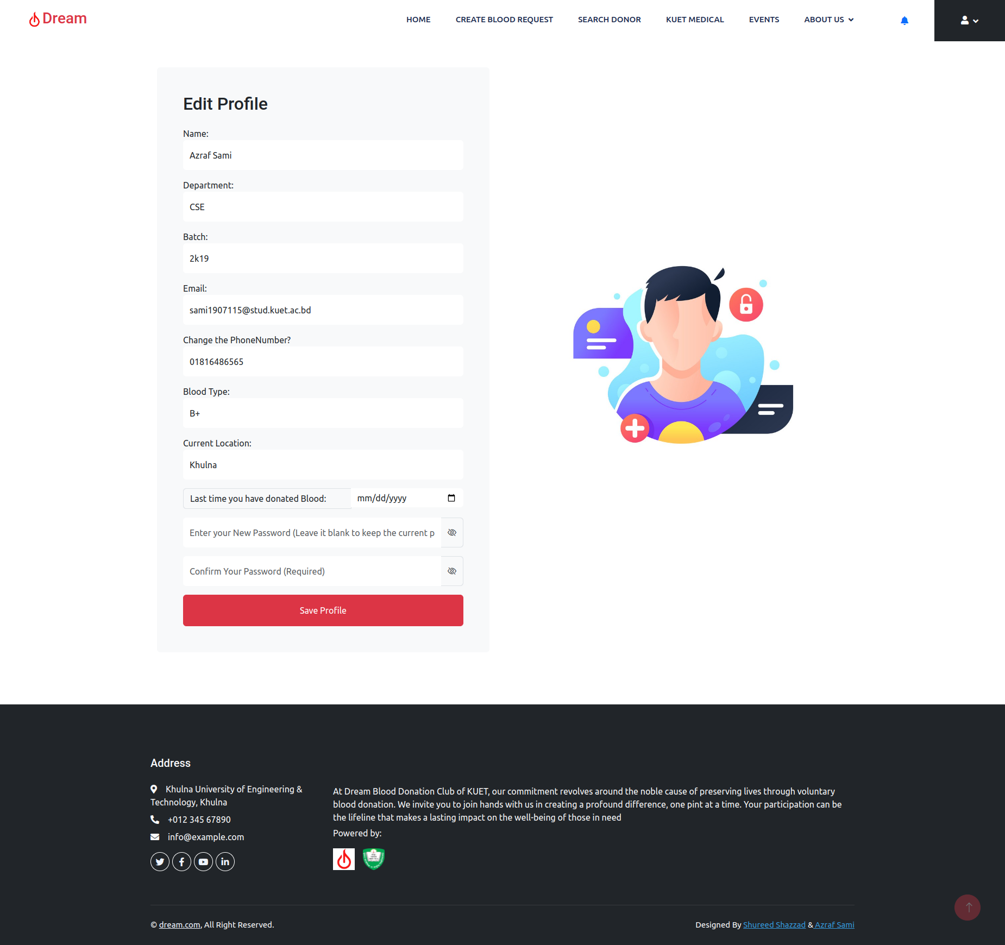
User Profile
User can update his profile information

Slide 42
Financial Analysis and Budget
Database Management Hosting:
Hosting Provider Costs (e.g., AWS, Heroku, DigitalOcean)
Server Resources (traffic and database size)
Database Service Costs (if using managed services)
Website Deployment:
Deployment Platform Costs (e.g., Heroku, AWS Elastic Beanstalk)
Domain Registration Expenses
SEO Optimization:
SEO Tools (e.g., Moz, SEMrush)
Keyword Research Budget
Content Optimization Costs
SEO Consultation (if needed)

Slide 43
Future Plan
Mobile App Development:
React Native Implementation for cross-platform compatibility.
Achieve feature parity with the website for a consistent experience.
User Experience Optimization:
Mobile-Optimized UI/UX for user-friendliness on various screens.
Responsive Design to adapt to different mobile devices.
Improved SEO Strategies:
App Indexing for search engine visibility.
Deep Linking for direct access from search results.
Push Notifications:
Integration for timely updates (events, reminders, health info).
Offline Functionality:
Provide offline access to critical features for connectivity challenges.

Slide 44
Conclusion
The project's primary objectives of automating donor communication and facilitating
blood donation requests have been met, overcoming the challenge of manual coordination.
The incorporation of doctor appointment scheduling extends the platform's utility, creating a holistic healthcare solution.The development process adhered to a well-defined project plan, utilizing tools such as Visual Studio Code, npm packages, and Redux for efficient and organized code development. The implementation of Redux provides a robust state management system, ensuring data consistency and facilitating seamless interactions.

Slide 45
References
[1] MongoDB Documentation - https://www.mongodb.com/
[2] Express - Node.js web application framework - https://expressjs.com/
[3] React Development Documentation - https://react.dev/
[4] node.js Documentation - https://nodejs.org/en/
[5] redux.js Documentation - https://redux.js.org/
[6] Additional Packages Documentation - https://www.npmjs.com/
[7] Telegram API Documentation - https://core.telegram.org/bots/tutorial

Slide 46
Thank you!

